Slide 1
Article title: The Driving Force and Progressive Mechanisms of Evolution Deduced from Thermodynamics
Supplementary File
Author: Ji-Ming Chen
Affiliation: Qingdao Agricultural University
The article was published on Preprints, 2020
https://www.preprints.org/manuscript/202010.0004/v3 https://www.preprints.org/manuscript/202010.0004/v2 https://www.preprints.org/manuscript/202010.0004/v1

Slide 2
This article proposes a novel evolutionary theory termed the CBEET = The CBE Evolutionary Theory
Small molecules containing carbon atoms (e.g. carbon dioxide, methane, ethanol)
Middle organic molecules (e.g. amino acids, nucleotides)
CBE
(carbon-based entity)
Large organic molecules (e.g. proteins, nucleic acids, lipids)
Organisms (e.g. bacteria, fungi, animals, plants)

Slide 3
Contents of this PPT
Major views of the CBEET versus previous theories
Thermodynamics of the CBEET

Slide 4
1. Major views of the CBEET versus previous theories
Previous theories
Speciation and increase of fitness of organisms
Multicellular organisms
Unicellular organisms
These notions have met challenges in multiple aspects, and have not integrated with these challenges
Survival of the fittest
(Charles Darwin’s theory)
Gradual replacement with those carrying advantageous mutations
(The Modern Synthesis)
Unknown process
Unknown reasons
Evolutionary process
Large organic molecules
Middle organic molecules
Reproduction of organisms with random genetic changes
Small inorganic and organic molecules
Notes:
Widespread and permanent relatively temperate heat streams

Slide 5
1. Major views of the CBEET versus previous theories
Increase of HHCBE diversity
Increase of HHCBE fitness
Increase of HHCBE order
Animal groups (e.g. societies of ants or bees with individual collaboration)
Survival of the fit & elimination of the unfit
Collaboration & altruism inside HHCBEs
Complicated functions of HHCBEs
The CBEET
Multicellular organisms (e.g. fungi, animals, and plants with intracellular collaboration)
Regeneration
of HHCBEs which usually carry some
changes
Increase of
the amount of HHCBEs which shall degrade later
Increase of structural complexity and hierarchy of CBEs
Unicellular organisms (units with the functions of self-replication & self-protection)
Progressive mechanisms
Complexes of large organic molecule aggregates (e.g. those for protein synthesis)
Many HHCBEs are relatively stable although they shall degrade later, and they can be hence accumulated
Evolutionary process
Many CBEs form higher-hierarchy CBEs (HHCBEs) through covalent bonds after absorbing heat, and many CBEs are mobile and can hence meet and collaborate with other CBEs to form HHCBEs not through covalent bonds
Large organic molecule aggregates
(e.g. lipid bilayer membrane, ion channels)
Evolutionary driving force
Large organic molecules
(e.g. proteins, nucleic acids, lipids)
Many carbon-based entities (CBEs) on the Earth spontaneously absorb heat from these heat streams
Middle organic molecules
(e.g. amino acids, nucleotides, glucose)
Widespread and permanent relatively temperate
heat streams on the Earth
Geothermal energy
Solar
energy
Other
energy
Small inorganic and organic molecules
(e.g. CO₂, CH₄, H₂O, H₂S, NH₃)
Notes:
Widespread and permanent relatively temperate heat streams

Slide 6
2. Thermodynamics of the CBEET
      Four laws of thermodynamics
      Two formulas of entropy
      Deduction of the driving force of evolution
      Deduction of progressive mechanisms of evolution
      Order, entropy, and evolution

Slide 7
2.1 Four laws of thermodynamics
Name | Statement
Zeroth law of thermodynamics | If two systems are both in thermal equilibrium with a third system (i.e. they are of the same temperature), then they are in thermal equilibrium with each other
First law of thermodynamics | Increase of internal energy of a closed system = the work the outside gives to the system + the heat the outside gives to the system
Second law of thermodynamics | Heat can spontaneously flow from a hotter location to a colder location, and cannot spontaneously flow from a colder body to a hotter body; the entropy of an isolated system never decreases over time
Third law of thermodynamics | The entropy of a system approaches a constant value as its temperature approaches absolute zero, and the entropies of perfect crystals at absolute zero temperature are zero
DeVoe H. Thermodynamics and chemistry. 2nd Edition. Version 10. http://www2.chem.umd.edu/thermobook/v10-screen.pdf. Accessed on Sep. 20, 2020.
Borgnakke C, Sonntag RE. Fundamentals of Thermodynamics. 8th edition. Hoboken, USA: John Wiley & Sons, 2013.

Slide 8
2.2 Two formulas of entropy
Name | Formula | Explanation
Clausius inequality | dS ≥ δQ/T | Macroscopically and thermodynamically, changes of entropy (dS) of a closed system are no less than δQ/T, where δQ denotes the amount of heat the outside gives to the target system
Boltzmann formula | S = K×LnΩ | Microscopically and statistically, entropy (S) quantifies the number of microscopic configurations termed microstates (Ω ) using Boltzmann constant (K). When a system has fewer microstates, its entropy declines Entropy is of additivity
DeVoe H. Thermodynamics and chemistry. 2nd Edition. Version 10. http://www2.chem.umd.edu/thermobook/v10-screen.pdf. Accessed on Sep. 20, 2020.
Borgnakke C, Sonntag RE. Fundamentals of Thermodynamics. 8th edition. Hoboken, USA: John Wiley & Sons, 2013.

Slide 9

Perfect crystals
at absolute zero is of
the lowest entropy
S = K×LnΩ = K×Ln1 =0

Slide 10
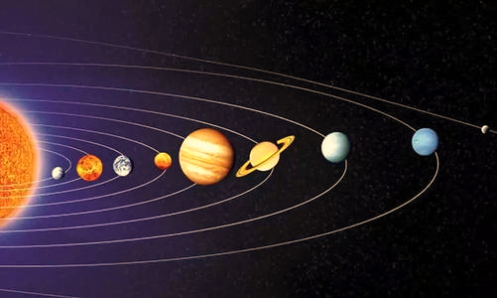
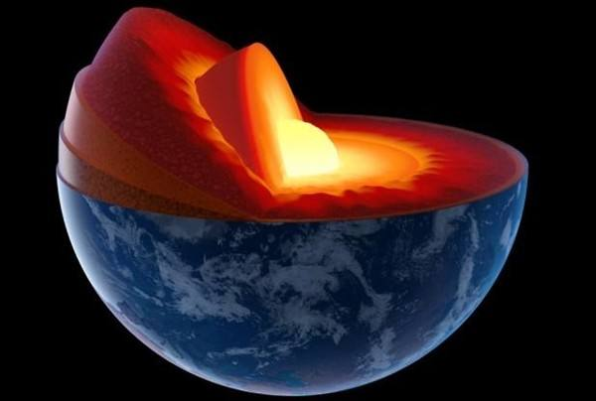
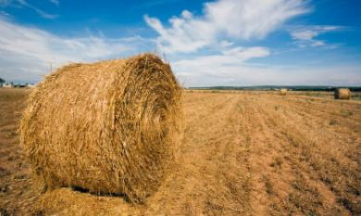
2.3 Deduction of the driving force of evolution
Our Earth is in a suitable orbit, and has received temperate solar energy for billions of years
（Solar energy）
Many sites on the Earth
have released
geothermal energy
for millions of years
(Geothermal energy)
Organisms, coals, and atomic energy can also provide much energy
(Other energy)

Slide 11
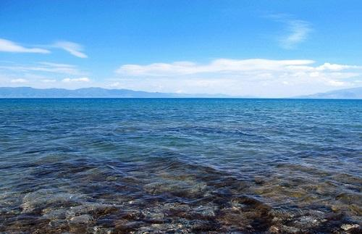


Huge amount of water on the Earth
Further regulates
the solar energy (heat) streams and the geothermal energy (heat) streams through evaporation, diffusion, and rainfall
Making the heat streams on the Earth
more temperate, last longer,
and distributed more widely

Slide 12

As per the second law of thermodynamics
When the temperate heat stream flow over cold stones and CBEs
Stones shall spontaneously absorb heat, and increase their entropies, microstates, temperatures, molecular movement rates
CBEs shall also spontaneously absorb heat, and increase their entropies, microstates, temperatures, molecular movement rates

Slide 13
As per the second law of thermodynamics
When the temperate heat stream flow over cold stones and CBEs
Stones shall spontaneously absorb heat, and increase their entropies, microstates, temperatures, molecular movement rates
CBEs shall also spontaneously absorb heat, and increase their entropies, microstates, temperatures, molecular movement rates
Thermodynamically, entropy, microstates, temperature, molecular movement rates are positively consistent with each other

Slide 14
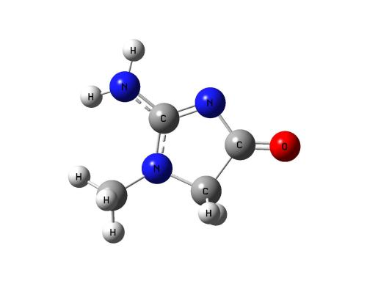
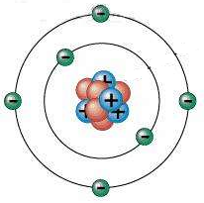
CBEs: different from stones
Carbon atoms are unique in sharing electrons with various atoms and form many soluble and flexible CBEs
CBEs can form higher-hierarchy CBEs (HHCBEs) after absorbing energy through forming covalent bonds
Carbon-based entities (CBEs)
Many CBEs are mobile and can hence meet and collaborate with other CBEs to form HHCBEs not through covalent bonds (e.g. lipid molecules can meet together and form bilayer membranes in this way)
HHCBEs are usually vulnerable and shall degrade sooner or later due to inner factors or outer factors
I, CBE, can change a lot
I can be very wonderful
Because I am good at sharing
Because I am mobile

Slide 15
Formation and accumulation of HHCBEs
Unlike stones, CBEs could form higher-hierarchy CBEs (HHCBEs), due to their increased molecular movement rates which could result in covalent bonds between CBEs, or due to collaboration of CBEs not through covalent bonds
Many HHCBEs are relatively stable, and thus these HHCBEs can be accumulated, albeit all HHCBEs shall degrade sooner or later

Slide 16
HHCBEs have thus accumulated
at a myriad of places for billions of years
Solar energy
Geothermal energy
Other energy
Due to widespread and permanent relatively temperate heat streams on the Earth

Slide 17
Animal groups (e.g. societies of ants or bees with individual collaboration)
Accumulation of synthesized HHCBEs
at a myriad of places
for billions of years
leads to
hierarchy-wise evolution
Multicellular organisms (e.g. fungi, animals, and plants with intracellular collaboration)
Unicellular organisms (units with the functions of self-replication & self-protection)
Complexes of large organic molecule aggregates (e.g. those for protein synthesis)
Large organic molecule aggregates
(e.g. lipid bilayer membrane, ion channels)
Large organic molecules
(e.g. proteins, nucleic acids, lipids)
Middle organic molecules
(e.g. amino acids, nucleotides, glucose)
Small inorganic and organic molecules
(e.g. CO₂, CH₄, H₂O, H₂S, NH₃)

Slide 18
2.4 Deduction of progressive mechanisms of evolution
Increase of HHCBE diversity
Increase of HHCBE fitness
Increase of HHCBE order
Arrows: the driving force mechanism
Arrows: the structural mechanism
Arrows: natural selection
Survival of the fit & elimination of the unfit
Collaboration & altruism inside HHCBEs
Complicated functions of HHCBEs
Regeneration
of HHCBEs which usually carry some
changes
Increase of
the amount of HHCBEs which shall degrade later
Increase of structural complexity and hierarchy of CBEs
Please see the main text for details on these mechanisms
Formation and accumulation of HHCBEs
The driving force from thermodynamics

Slide 19
2.5 Order, entropy, and evolution
Increase of HHCBE diversity
Increase of HHCBE fitness
Increase of HHCBE order
Order in biology
results from billions of years of evolution
Survival of the fit & elimination of the unfit
Collaboration & altruism inside HHCBEs
Complicated functions of HHCBEs
Regeneration
of HHCBEs which usually carry some
changes
Increase of
the amount of HHCBEs which shall degrade later
Increase of structural complexity and hierarchy of CBEs
Formation and accumulation of HHCBEs
The driving force from thermodynamics

Slide 20
The thermodynamic view of the CBEET is consistent with what Boltzmann said in 1886
This scientist created the Boltzmann formula of entropy
“The general struggle for existence of animate beings is therefore not a struggle for raw materials - these, for organisms, are air, water and soil, all abundantly available - nor for energy which exists in plenty in any body in the form of heat (albeit unfortunately not transformable), but a struggle for entropy, which becomes available through the transition of energy from the hot sun to the cold earth.
      Boltzmann L. The second law of thermodynamics. In Theoretical physics and philosophical problems (pp. 13-32). Dordrecht, Netherlands: Springer, 1974.

Slide 21
How Wikipedia cited these sentences?
(https://en.wikipedia.org/wiki/Entropy_and_life)
“The general struggle for existence of animate beings is therefore not a struggle for raw materials - these, for organisms, are air, water and soil, all abundantly available - nor for energy which exists in plenty in any body in the form of heat (albeit unfortunately not transformable), but a struggle for [negative] entropy, which becomes available through the transition of energy from the hot sun to the cold earth.
Why Wikipedia intentionally added “negative” before “entropy” ?

Slide 22
“Negative entropy” developed by Erwin Schrödinger
The fact that evolution leads to increase of order in biology, is assumed to be contrary to the second law of thermodynamics leading to increase of entropy or chaos in physics
Scientists assumed that organisms are low-entropy systems, and that they keep low entropy through metabolism which absorbs low-entropy matter and discharges high-entropy matter
The notion of “negative entropy” was thus established and widely accepted. Negative entropy = Low entropy of absorbed matters − High entropy of discharged matters
Schrödinger E. What is life – the physical aspect of the living cell.
Cambridge University Press, 1944.

Slide 23
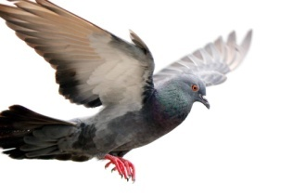


We believe “Negative entropy” is wrong
Order in biology is largely contrary to order in physics as per the two formulas of entropy
Order in biology
(Flying pigeon)
Order in physics
(Cold perfect crystal)
Change differently
on the same organism
Moving
Warm
Mixed
Asymmetric
Many microstates
High entropy
Static
Cold
Pure
Symmetric
Few microstates
Low entropy
Entropy of this dog
is declining
while it is dying on the ice
with heat being lost from the body
(its order in physics is increasing)
(its order in biology is decreasing)
S = K×LnΩ
(The Boltzmann formula)
dS ≥ δQ/T
The Clausius inequality

Slide 24

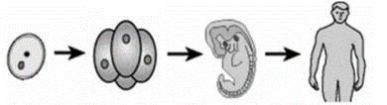
We believe “Negative entropy” is wrong
Entropy of what we eat > Entropy of what we discharge
A Simplified Scenario
All the amino acids infused into the body become proteins of the needed body without discharge
(Entropy of the body increased)
As per the additivity of the entropy
Entropy of this zygote
increased by billions of times
when it becomes a man
(without decline of order in biology)
Animate beings struggle for entropy, as elucidated by Boltzmann in 1886
Boltzmann L. The second law of thermodynamics. In Theoretical physics and philosophical problems (pp. 13-32). Dordrecht, Netherlands: Springer, 1974.

Slide 25
We believe “Negative entropy” is wrong
Order in biology is accumulated through natural selection for billions of years
Increase of HHCBE diversity
Increase of HHCBE fitness
Increase of HHCBE order
Order in biology
does not result from
a short-time input of
“negative entropy”
Survival of the fit & elimination of the unfit
Collaboration & altruism inside HHCBEs
Complicated functions of HHCBEs
Regeneration
of HHCBEs which usually carry some
changes
Increase of
the amount of HHCBEs which shall degrade later
Increase of structural complexity and hierarchy of CBEs
Formation and accumulation of HHCBEs
The driving force from thermodynamics

Slide 26
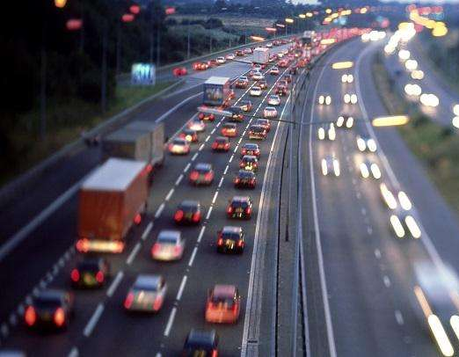



Orders in the wonderful world are more than order in physics are not always with low entropy
These orderly systems all have high entropy
(Order should not be hooked with entropy)

Slide 27
When “negative entropy” was proposed
Erwin Schrödinger met criticism from physicists
He stated “if I had been catering for them alone I should have let the discussion turn on free energy instead”
He likely knew that “negative entropy” is not scientific
He was reluctant to abandon “negative entropy”
Schrödinger E. What is life – the physical aspect of the living cell. Cambridge University Press, 1944.

Slide 28

Without the interference of “negative entropy”
The driving force of evolution is so simple
Due to the widespread and permanent relatively temperate heat streams on the Earth
CBEs spontaneously absorb heat from the heat streams, increase their entropy, and form higher-hierarchy CBEs (HHCBEs)
Accumulation of HHCBEs at a myriad of places for billions of years leads to evolution

Slide 29
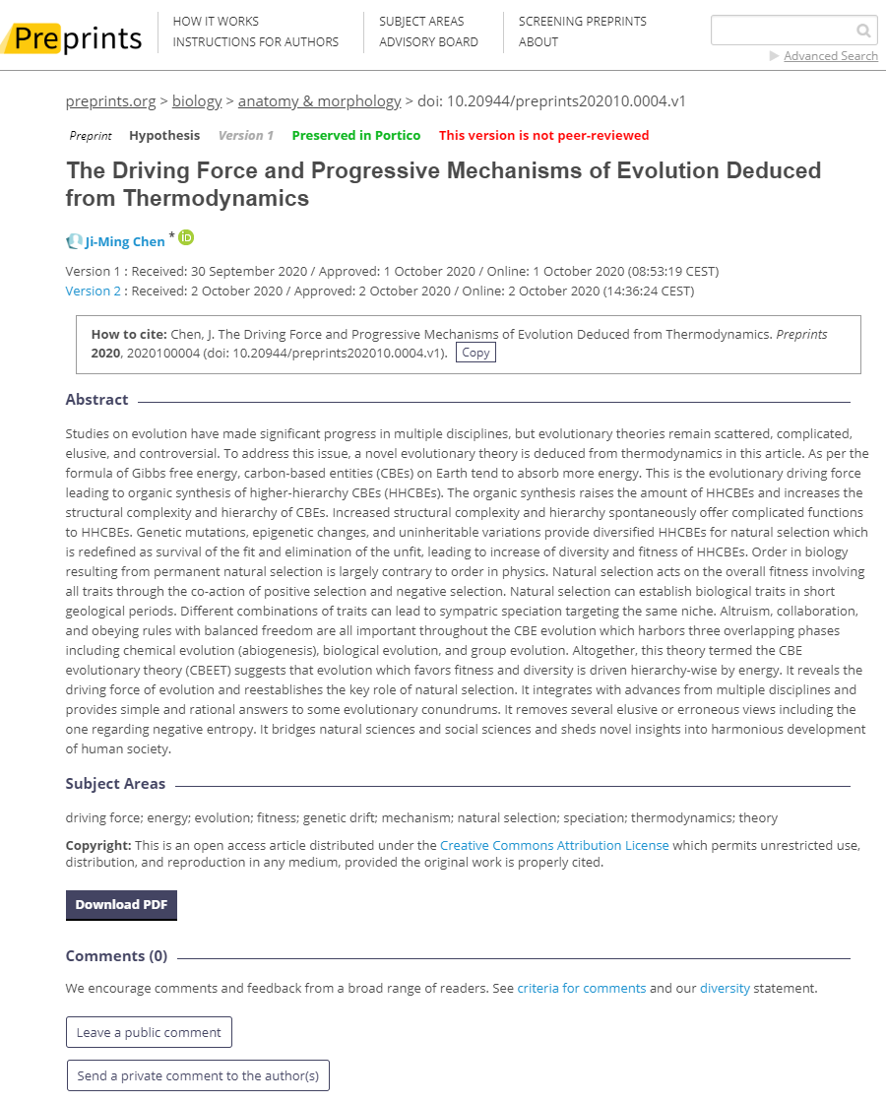
Thank you for watching the thermodynamic part of the article
Looking forward to your precious comments online
https://www.preprints.org/manuscript/202010.0004/v3
or email to me jmchen678@qq.com

