Slide 1
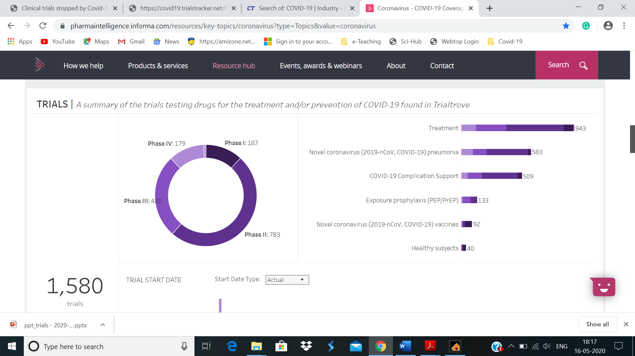
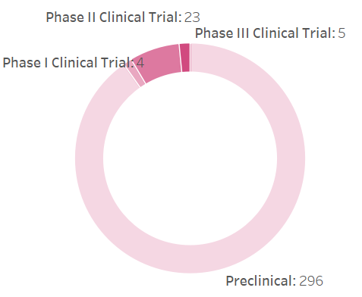
(A)
(B)
(C)
Figure 1

Slide 2
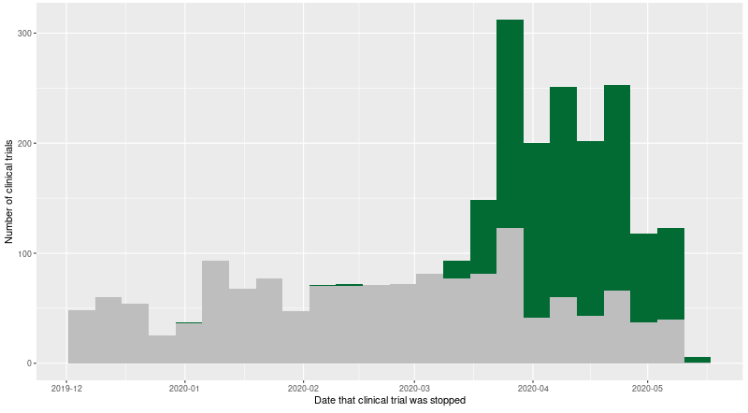
Figure 2

Slide 3
(A)
(B)
(C)
Figure 3

Slide 4
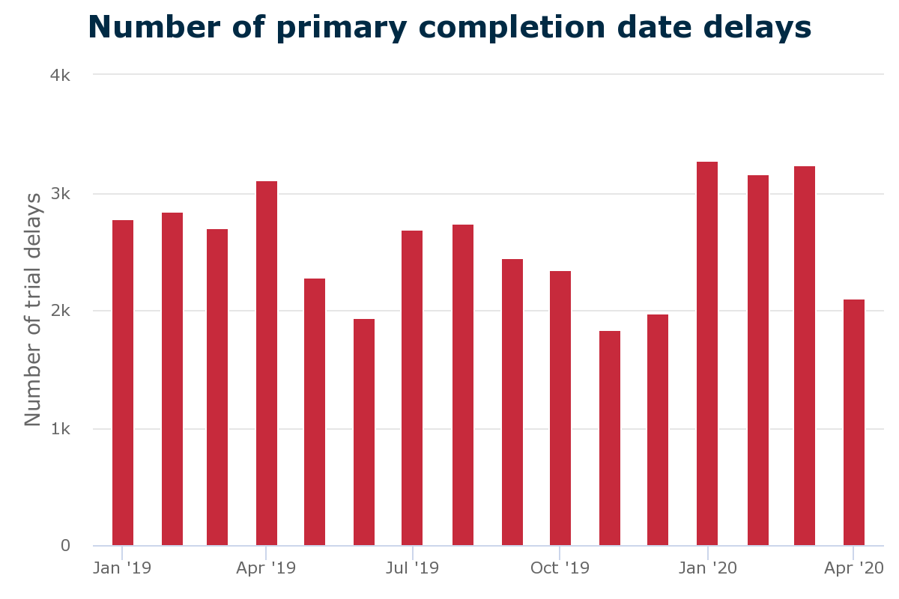
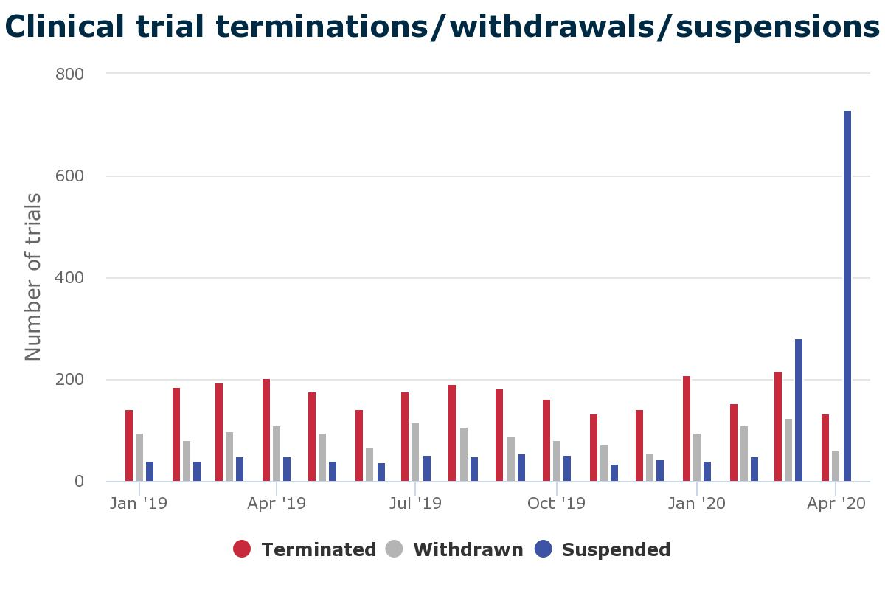
(A)
(B)
Figure 4

Slide 5
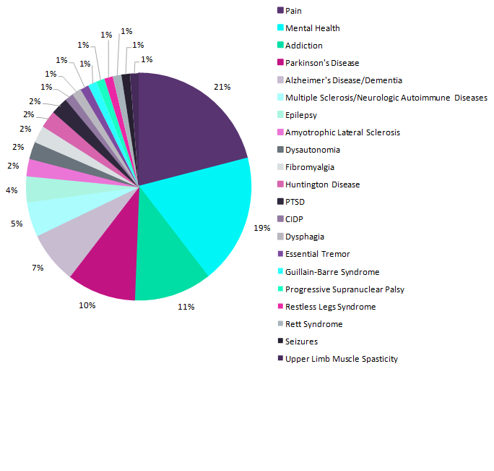
Figure 5

