Slide 1
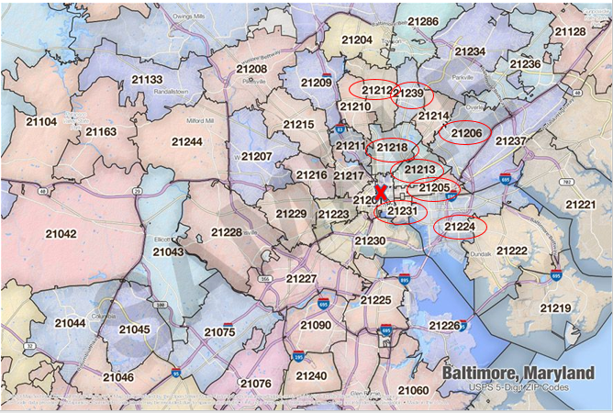
Supplemental Figure 1: High-risk zip codes in East Baltimore
Zip codes including 21205, 21206, 21212, 21213, 21218, 21224, 21231, 21239. X is the approximate location of Johns Hopkins Hospital

