Slide 1
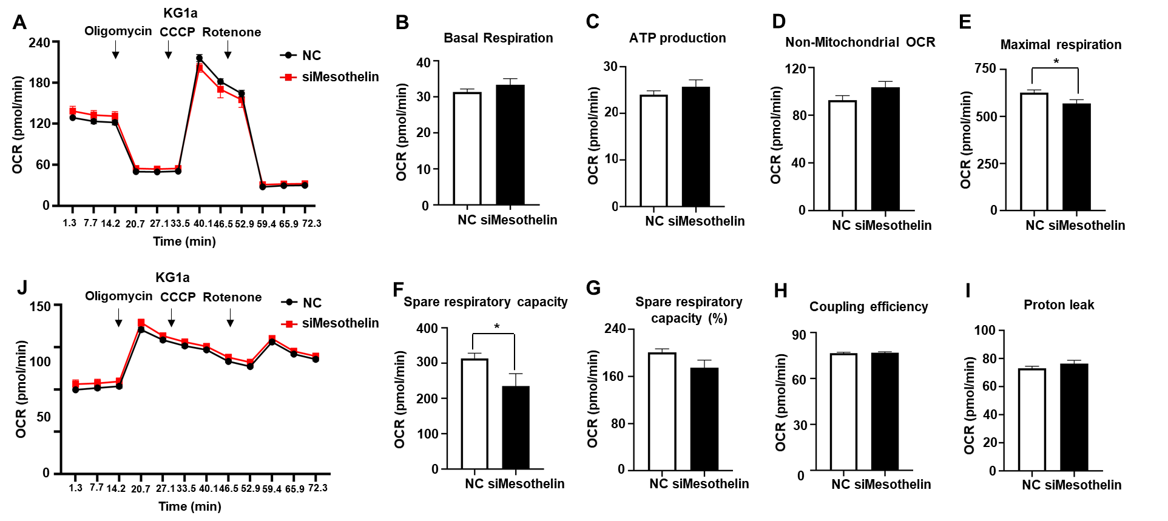
Supplementary Fig. 1

Slide 2
Supplementary figure 1. Effect of mesothelin knockdown on oxygen consumption rate in KG-1a cells. A, KG1α cells were incubated in media containing siRNA targeting mesothelin for 72 hours. OCR was measured using XFe96 analyzer after sequential injection of mitochondrial inhibitors. B-I, Values of OCR parameters were calculated using WAVE software. J, ECAR was measured along with OCR after mitochondrial inhibitor injection. The black line indicates OCR or ECAR of KG1α cells transfected with negative control and the red line represents transfected with siRNA targeting mesothelin. Values are presented as mean ± SD (bars) (*P < 0.05 vs. corresponding control).

