Slide 1
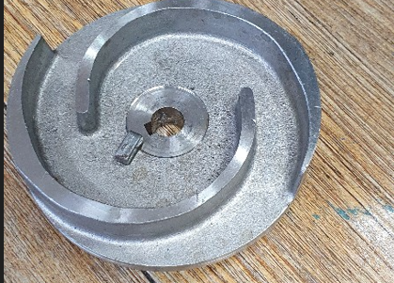
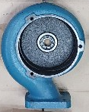
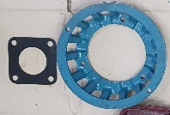
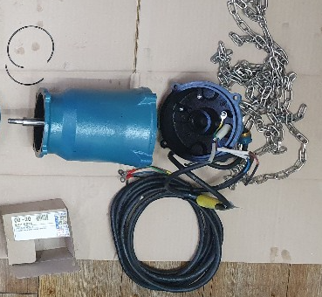
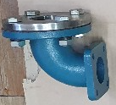



2.1 Pump Dimensions and 3D model
DWE-08B
O’ring
Motor lid
Impeller
Casing
Suction stand
Motor
Cable
Bolt
Discharge elbow
Suction cover
Filter
Figure 1. Disassemble of the submersible drainage pump (DWE-08)

Slide 2
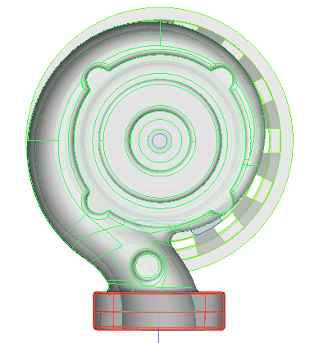
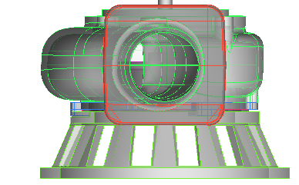
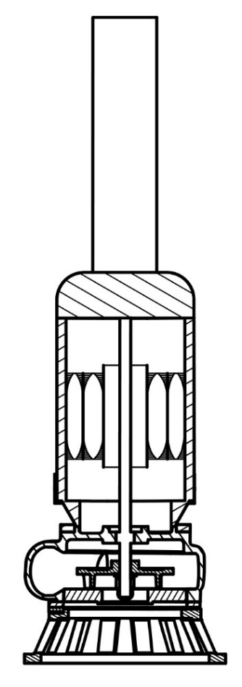
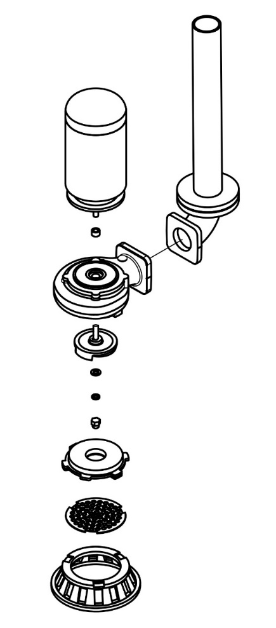


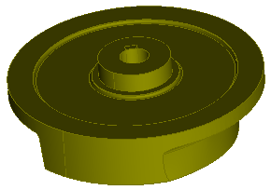
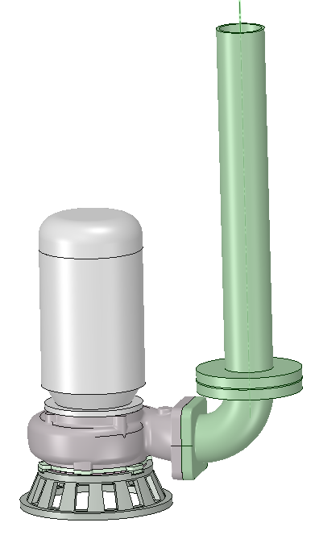
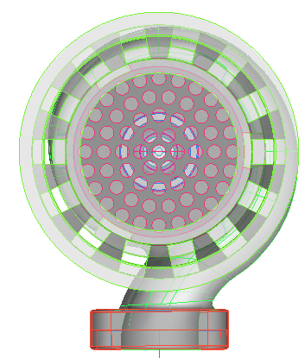
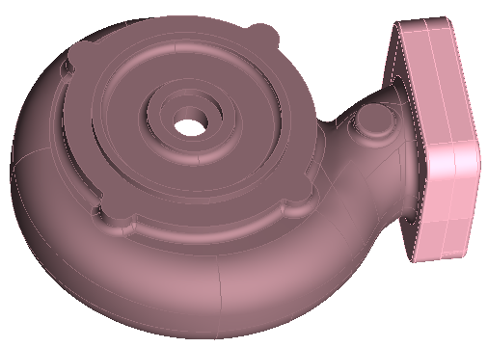
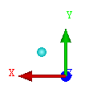
Motor
Discharge elbow
Bottom view
Front view
Casing
Shaft
Impeller
Ring/spring washer/shaft bolt
Impeller
Suction cover
Filter plate
Suction stand
Casing
Pump assembly and disassembly
Complete pump model
Back view
Figure 2. Assembly and disassembly drawing of the submersible drainage pump (DWE-08B) and its different views.

Slide 3
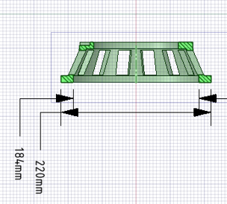
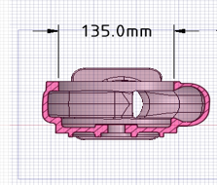

Impeller
Casing
Suction plate
Suction stand
Figure 3. Cross-sectional view of the pump’s key components.

Slide 4
Table 1. Original submersible pump model (DWE-08B) design parameters.
Description | Power | Flow rate | Head | Impeller |  |  | Casing
 |  |  |  | Blades | D1 | D2 | Flow path height | Inlet height | Outlet dia.
Model | H.P. | m³/min | m | No. | mm | mm | mm | mm | mm
DWE-08B | 1 | 0.16 | 10 | 2 | 25 | 105 | 54 | 135 | 60

Slide 5
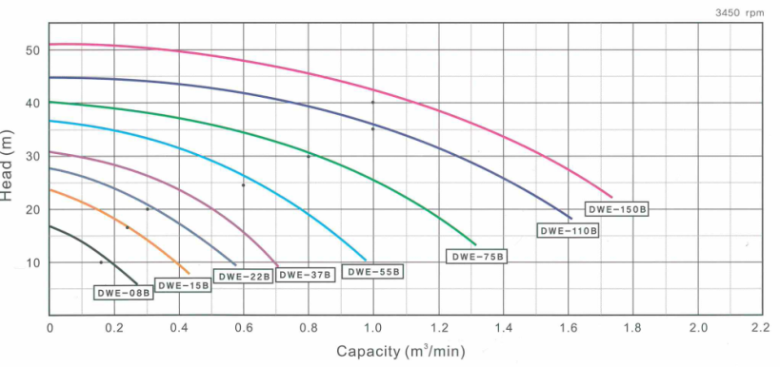
3450 rpm
Head (m)
Capacity (m³/min)
Figure 4. H-Q curve of submersible pumps presented in the catalog [2].

Slide 6
Table 2. Submersible pump performance data [2].
Model | Outlet height (mm) | Power (H.P.) | Flow rate (m³/min) | Head (m)
DWE-08B | 50 | 1 | 0.16 | 10

Slide 7
Measure pump dimensions
2D drawing
3D modelling
3D scanned shape
Numerical analysis
Performance validation
Experiment
Design modifications
Casing shape
Impeller shape
Flow balance block
No
Optimum model
Yes
Hydraulic performance improvement
3D printing technology
Final model
Manufacture
Figure 5. 2 Hydraulic performance optimization procedure of the submersible drainage pump.

Slide 8

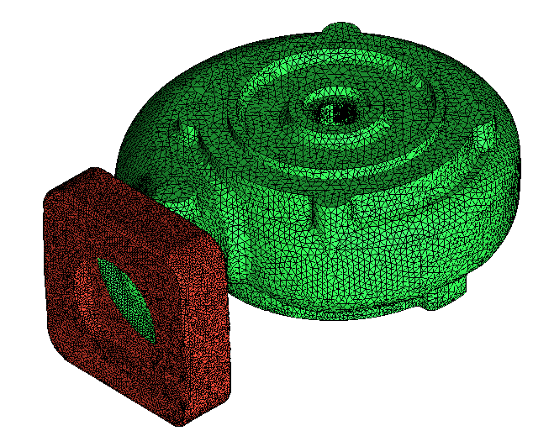
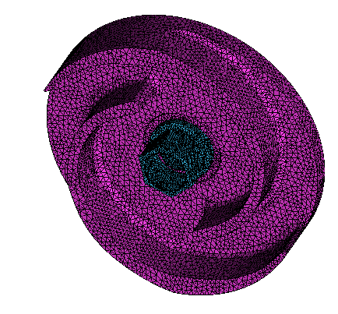
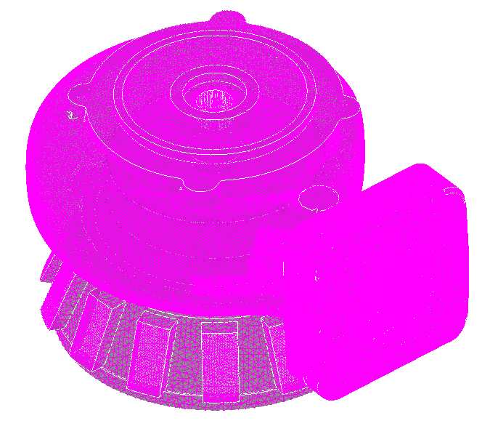
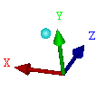
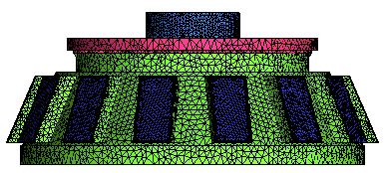
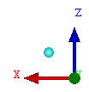
Casing
Impeller
Pump meshing
Suction stand
Figure 6. Submersible pump meshing grids for computation.

Slide 9
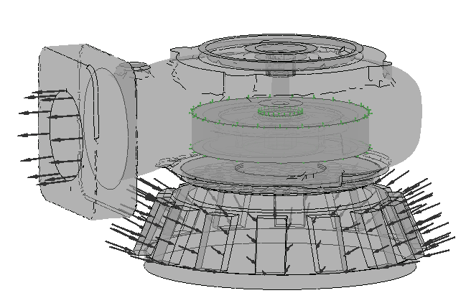

3450 rpm
Interfaces
Outlet
P = 0 Pa
Inlet
mass flow rate
Figure 7. Boundary conditions of the computational domain.

Slide 10
Table 3. Meshing grids of the DWE-08 submersible pump.
Description | Elements | Nodes
Model 1 | 272,563 | 1,374,829
Model 2 | 532,924 | 2,733,319
Model 3 | 1,085,683 | 5,648,730

Slide 11
Figure 8. Performance comparison between the experiment and computational of the submersible pump (a) Head vs. flow rate and (b) Efficiency vs. flow rate (Experimental uncertainty in N±3.298 rpm, Q±0.00178 m3/min, H±0.0989 m, and P±0.0102 kW).

Slide 12
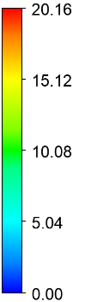
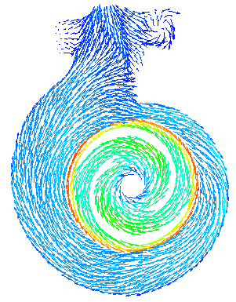
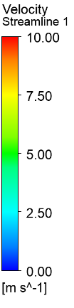
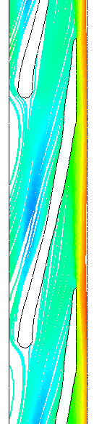
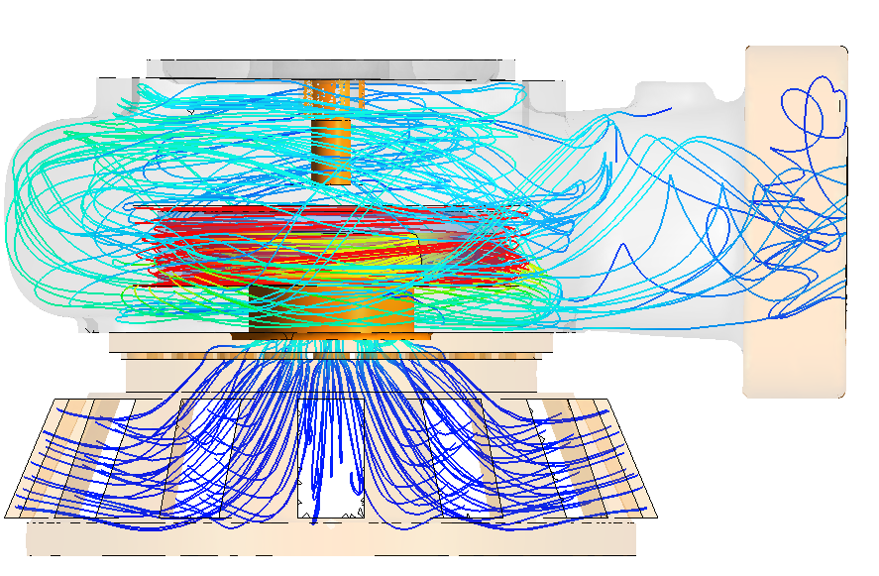
Velocity Vectors
Velocity Streamline
Velocity Streamline
Large gap in the upper part of the impeller within the casing (more than 2 mm)
(m s⁻¹)
(m s⁻¹)
(m s⁻¹)
Figure 9. Velocity distributions analysis inside the casing (a) velocity vectors (b) velocity streamlines, (c) Blade-to-blade velocity streamlines.

Slide 13
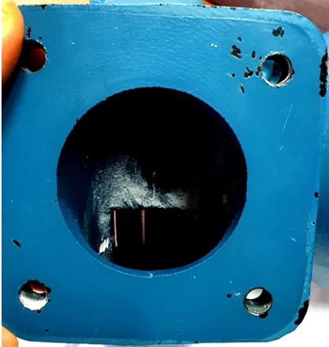
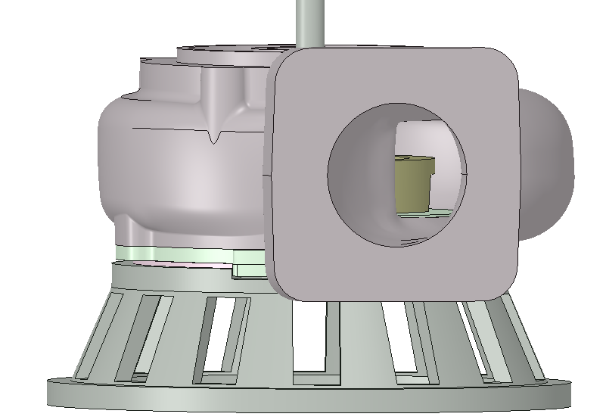
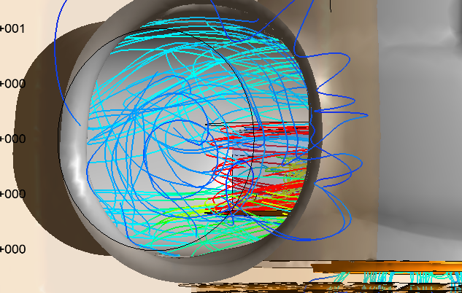
Figure 10. The position of the impeller inside the casing of the pump.

Slide 14
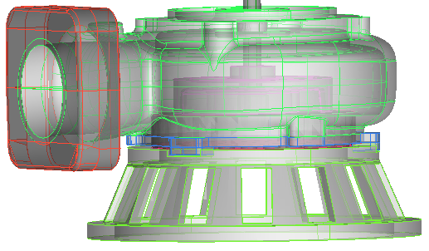
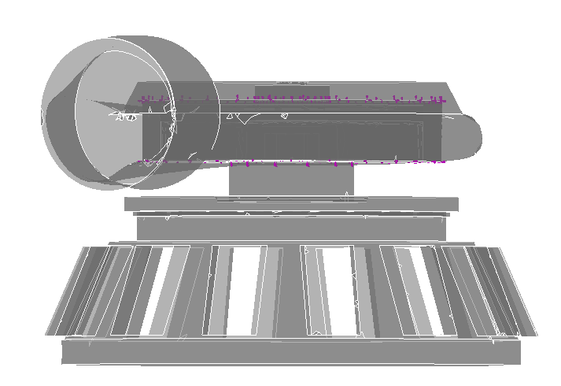
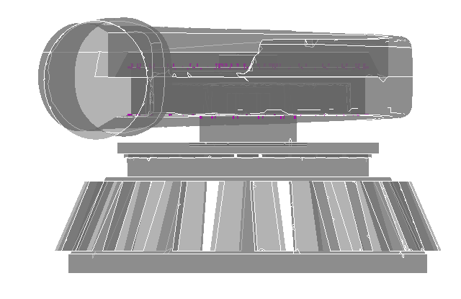
(a) Original model
(b) Model 1
(c) Model 2
Fig. 11 Casing shape change model (a) original impeller, (b) Model 1, (c) Model 2.

Slide 15
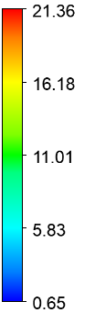


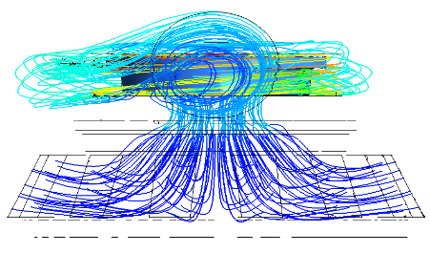
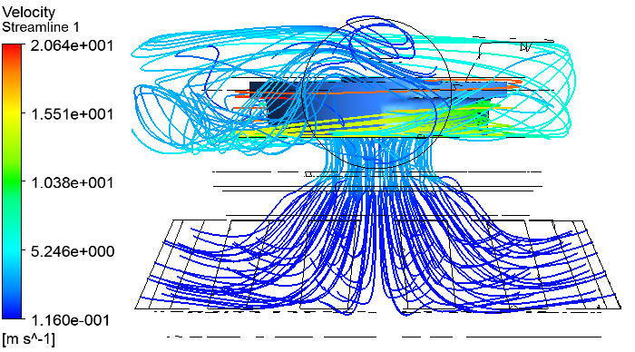
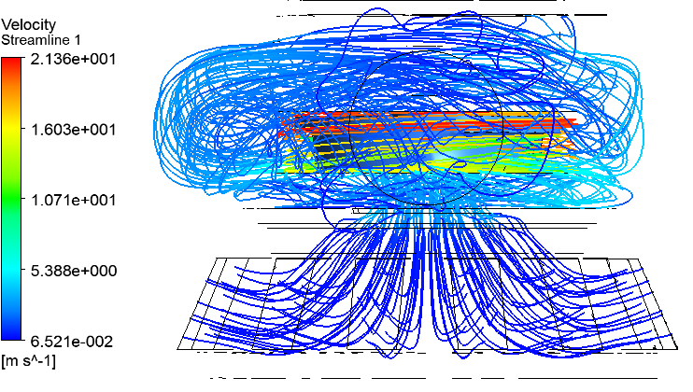
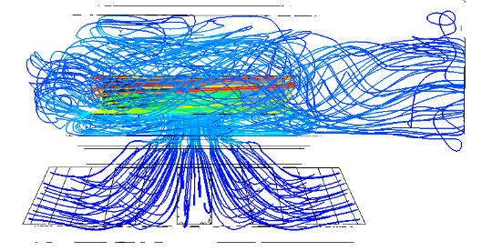
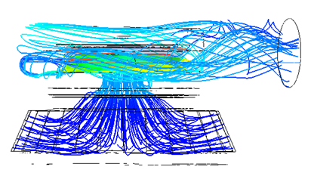
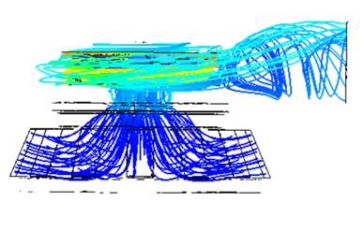
Velocity Streamline
Velocity Streamline
Velocity Streamline
(m s⁻¹)
(m s⁻¹)
(m s⁻¹)
Velocity Streamline
Velocity Streamline
Velocity Streamline
(m s⁻¹)
(m s⁻¹)
(m s⁻¹)
(a) Original model
(b) Model 1
(c) Model 2
Figure 12. Velocity streamlines comparison of shape change model (a) original model (b) model 1 (c) model 2.

Slide 16
Figure 13. Performance comparison for casing shape change model (a) original model (b) model 1 (c) model 2.

Slide 17
Table 4. Comparison of pump efficiency according to casing shape changed model.
Flow rate (m³/min) | Original (%) | Model 1 (%) | Model 2 (%) | Efficiency improvement (%)
 |  |  |  | Model 1 | Model 2
0.10 | 34.593 | 40.542 | 38.904 | 5.949 | 4.311
0.14 | 40.420 | 48.358 | 45.474 | 7.938 | 5.054
0.16 | 45.415 | 50.687 | 49.230 | 5.272 | 3.815
0.17 | 46.375 | 51.513 | 49.301 | 5.138 | 2.926
0.20 | 46.921 | 52.826 | 52.357 | 5.905 | 5.436
0.22 | 46.562 | 53.487 | 52.221 | 6.925 | 5.659

Slide 18
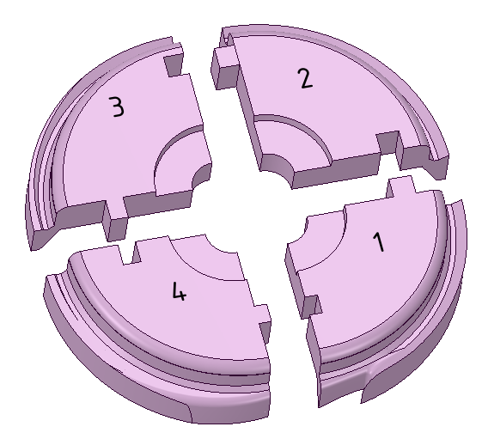
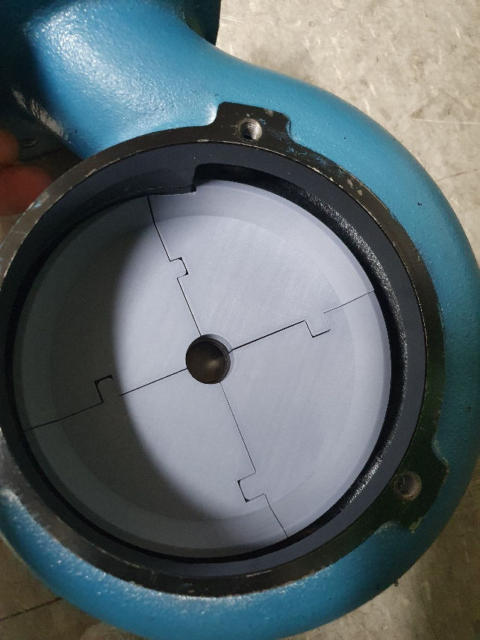
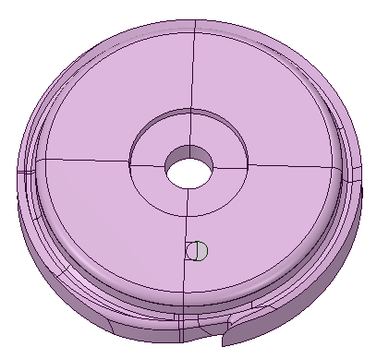
Figure 14. Flow balance block model.

Slide 19

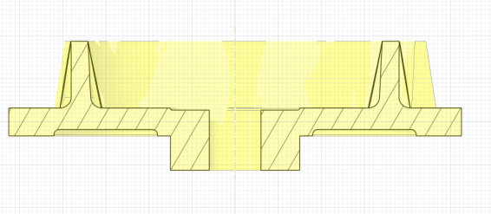
Figure 15. Impeller shape model 1.

Slide 20
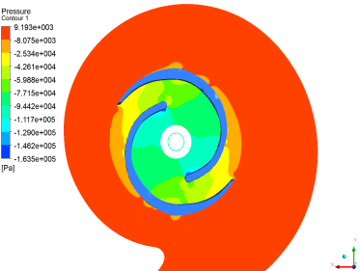
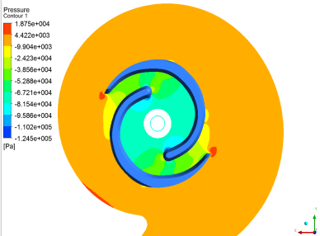
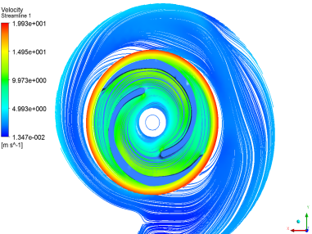
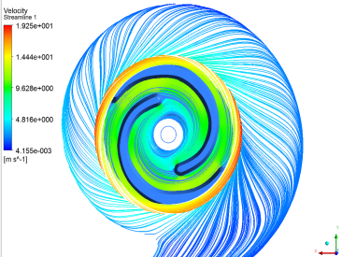










Plane 1
plane1
plane2
plane3
plane1
Plane 2
plane2
plane3
Plane 3
(a) Original
(b) Imp. Model 1
(a) Original
(b) Imp. Model 1
Figure 16. Pressure and velocity streamline distribution in different planes (a) original impeller, (b) impeller model 1.

Slide 21
Figure 17. Performance comparison of impeller shape change model.

Slide 22

(a) Impeller model 1
(b) Manufactured impeller
Figure 18. Cross-sectional view of the optimum model (a) impeller model 1 (b) manufactured model.

