Slide 1
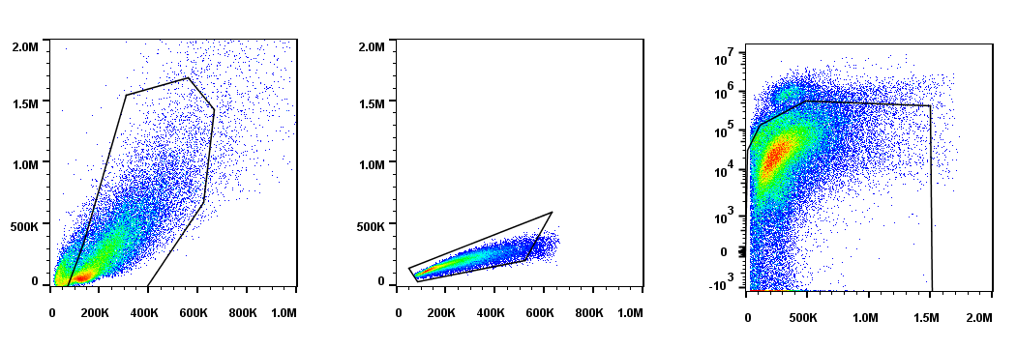
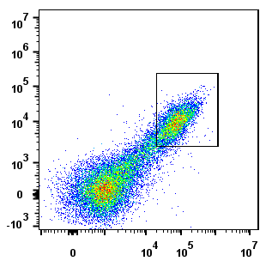
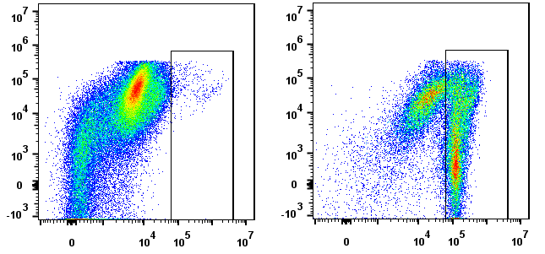
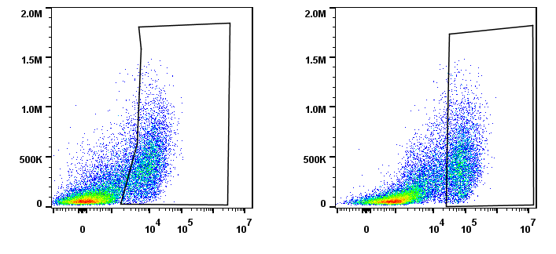
SSC-A
FSC-H
Live – e780
89.7%
FSC-A
FSC-A
SSC-A
Sample
27.5%
FMO PE
Sample
CLEC4F - AF647
60%
Live – e780
TIM-4 – PerCP e710
CD45.2-PE
CLEC4F - AF647
TIM-4 – PerCP e710
SSC-A
or
FMO
Marker
Counts
Respective marker
Figure S1. Gating strategy for phenotypic characterization of primary KCs. Myeloid cell populations were isolated from livers of C57BL/6 mice. Live CD45+ CLEC4F+ TIM-4+ primary KC cells were analyzed for the expression of CLEC4F, F4/80, CD11B, TLR4, CD14, CLEC4F and TIM-4 by flow cytometry. Fluorescent minus one (FMO) controls were used to set gates and served as negative control for their respective marker expression comparison. (n=3; two-livers pooled per group, per experiment).

Slide 2
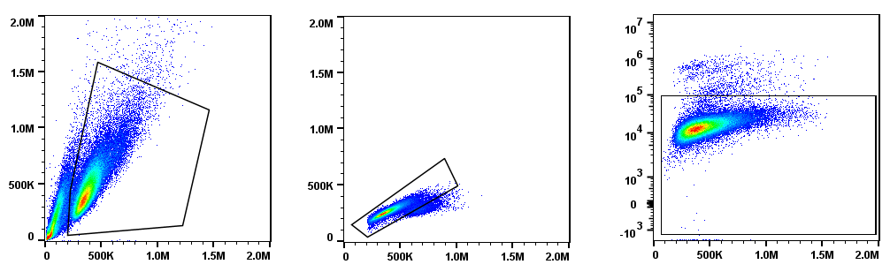
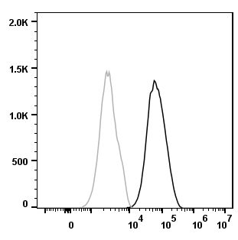
SSC-A
FSC-H
Live – e780
FSC-A
FSC-A
SSC-A
FMO
Marker
Counts
Respective marker
Figure S2. Gating strategy for phenotypic characterization of ImKCs. ImKCs were phenotypically characterized by flow cytometry for the expression of macrophage and Kupffer cell-specific markers F4/80, CD11B, TLR4, CD14 and CLEC2. Representative flow cytometry plots from three independent biological experiments. Fluorescent minus one (FMO) controls were used to set gates and served as negative control for their respective marker expression comparison.

Slide 3
Figure S3. EBOV ΔVP30 infection (MOI=1) of ImKC-VP30 cells is inhibited by IFN-γ treatment. EBOV VP30 expressing ImKCs were polarized with IFN-γ (20 ng/mL) for 24 h, media replaced and then infected with EBOV ΔVP30 at a MOI of 1 (n=3, three independent biological experiments). GFP expression was assessed by flow cytometry after 48hpi. Data represent the mean ± SD. P values were obtained by unpaired one-tailed t-test. P values were obtained unpaired t-test. ***P<0.0001).

Slide 4
(day -1)
Figure S4. ImKC-VP30 cell viability following IFN-γ treatment. EBOV VP30 expressing ImKCs were polarized with IFN-γ (20 ng/mL) for 24 h, media replaced and then lysed at the different time points noted to quantify ATP via ATPlite™ assay (n=5, two independent biological experiments). Data shown represent the mean ± SD.

Slide 5
Figure S5. IFN-γ and conditioned media from IFN-γ treated cells blocks rVSV/G infection. IFN-γ (20 ng/ml) was added to ImKC-VP30 cell cultures. For production of conditioned media from IFN-γ ImKC-VP30 cells, confluent cultures were treated with IFN-γ for 24 h, media was removed, cells washed and media was added back to the culture for 24 hours. Supernatants were collected, filtered through a 0.45 μ filter and either stored at -80°C or directly used.

