Slide 1
(Supplementary data: Figures & Tables)

Slide 2
Figure S1: A) Anion-exchange followed by B) gel filtration chromatography was employed to purify Tyrosinase.
A)
mA at 280 nm
Unbound fraction
100
Peak I
75
Peak II
% of NaCl
50
25
B)
0.0
Elution volume (ml)
mA at 280 nm
Injection Flow rate maintained 0.5 ml
Peak I
Elution volume (ml)

Slide 3
Figure S2: Michaelis-menten kinetics in presence and absence of Santalol as inhibitor (0-50 µM)

Slide 4
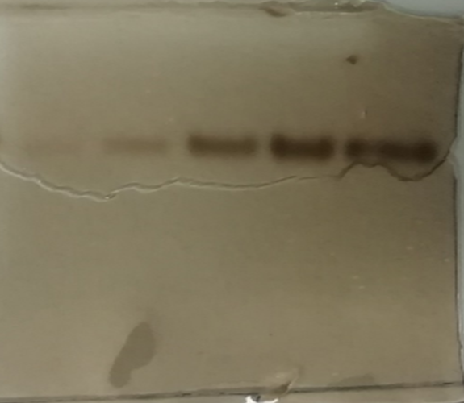
Figure S3: native-PAGE Profile (zymogram) obtained after incubation in tyrosine substrate solution 5mM for about 24 hours indicating the formation of dark-brown melanin pigment (loaded in increasing conc gradient from lane 1 to lane 5
1 2 3 4 5

Slide 5
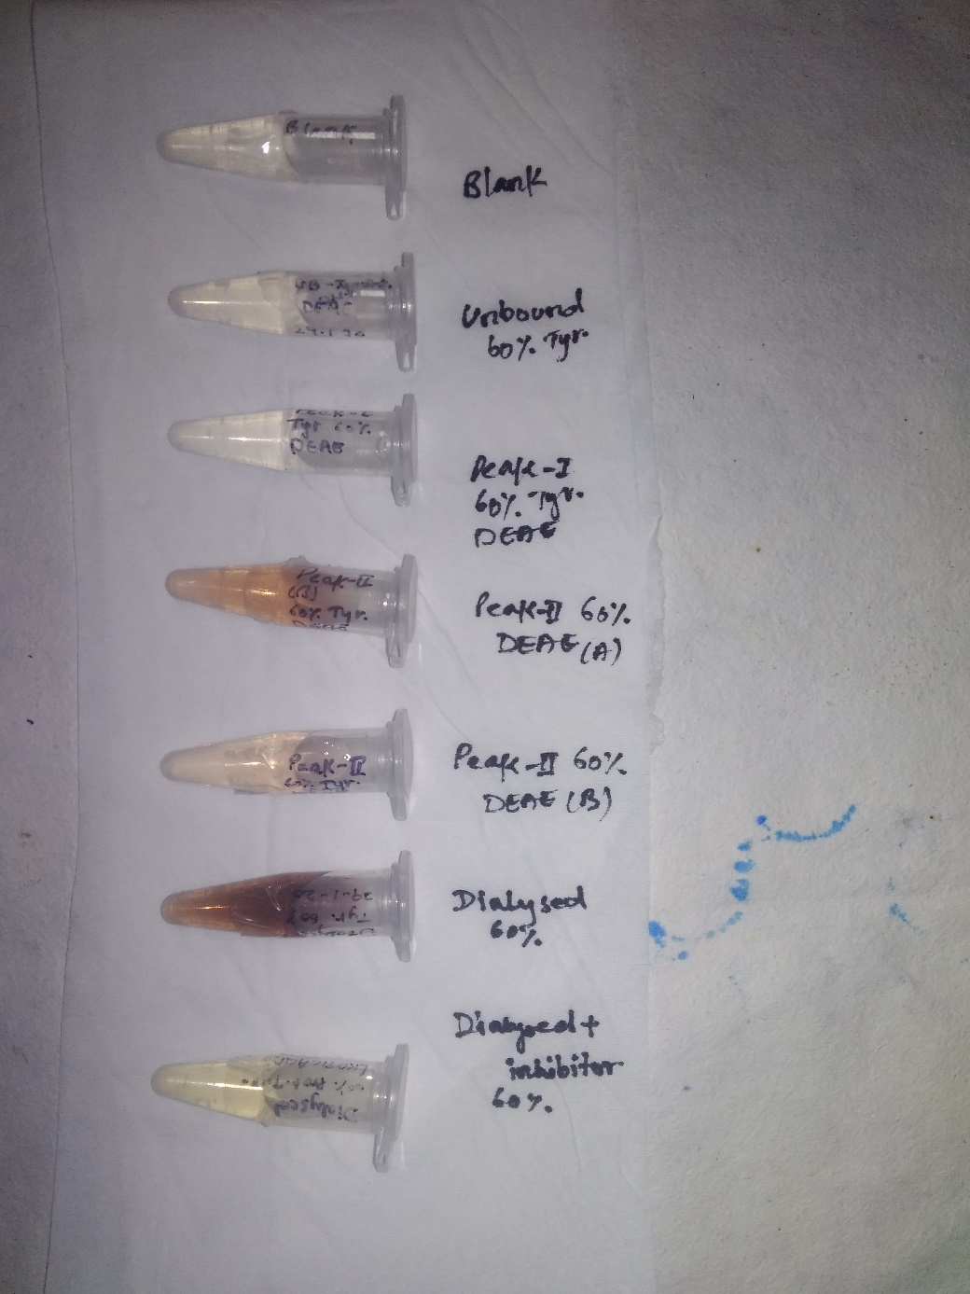
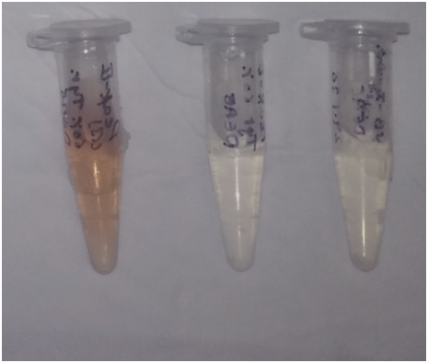
Figure S4. Colorimetric assay done in presence and absence of santalol & kojic acid.
1 2 3
2A 1A 3A
1: Native/Purified Tyrosinase with its substrate (No inhibitor present in reaction mixture).
2: Protein in presence of standard inhibitor, Kojic Acid 50 µM.
3: Protein in presence of Santalol 50 µM as tyrosinase inhibitor.
1A, 2A, 3A : Indicating Same reaction mixture after 24 hr of incubation.
Sample No. | OD _{473 nm}
1 | 0.50
2 | 0.15
3 | 0.20
Sample No. | OD _{473 nm}
1A | 0.81
2A | 0.20
3A | 0.30

Slide 6
Figure S5 : 2D ligand interaction studies in between (A) Kojic acid-tyrosinase and (B) Santalol-tyrosinase complex.

Slide 7
S

Slide 8
Table S2: Toxicity evaluation of (Santalol) with machine learning methods using pkCSM server.
S.No. | Parameters | Predicted outcome | Unit
1 | AMES toxicity | No | Categorical (Yes/No)
2 | Max. tolerated dose (human) | -0.352 | Numeric (log mg/kg/day)
3 | hERG I inhibitor | No | Categorical (Yes/No)
4 | hERG II inhibitor | No | Categorical (Yes/No)
5 | Oral Rat Acute Toxicity (LD50) | 1.589 | Numeric (mol/kg)
6 | Oral Rat Chronic Toxicity (LOAEL) | 1.24 | Numeric (log mg/kg_bw/day)
7 | Hepatotoxicity | No | Categorical (Yes/No)
8 | Skin Sensitisation | Yes | Categorical (Yes/No)
9 | T. Pyriformis toxicity | 1.997 | Numeric (log ug/L)
10 | Minnow toxicity | 0.531 | Numeric (log mM)

