Slide 1
Figure 1

Slide 2
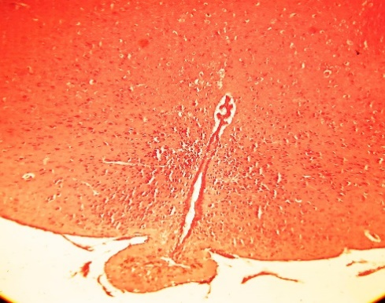
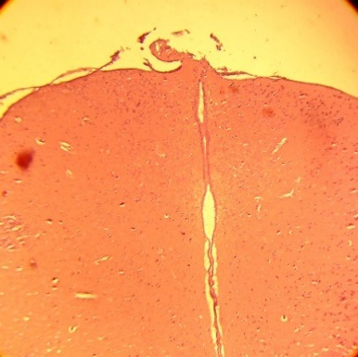
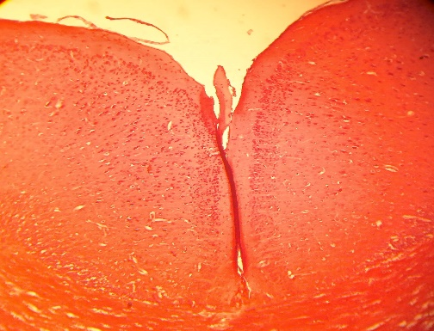
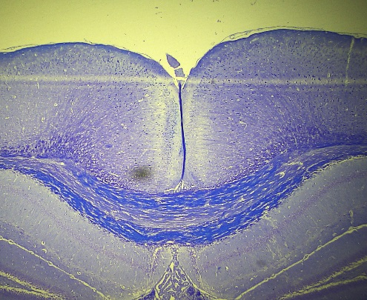
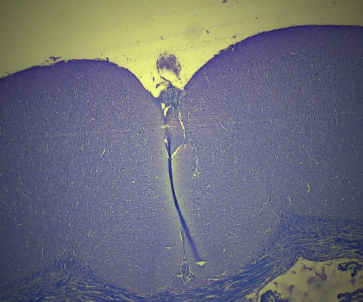
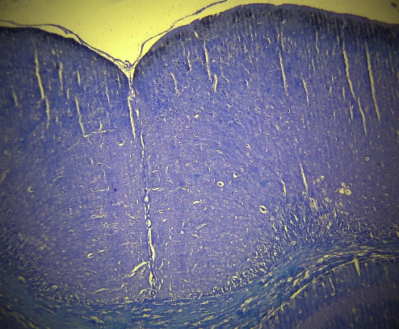
Figure 2
CTRL
Prevention
Treatment
(a)
(b)
(c)

Slide 3
Figure 3

Slide 4
Figure 4
(a)
(b)

Slide 5
Figure 5
(a)
(b)

