Slide 1
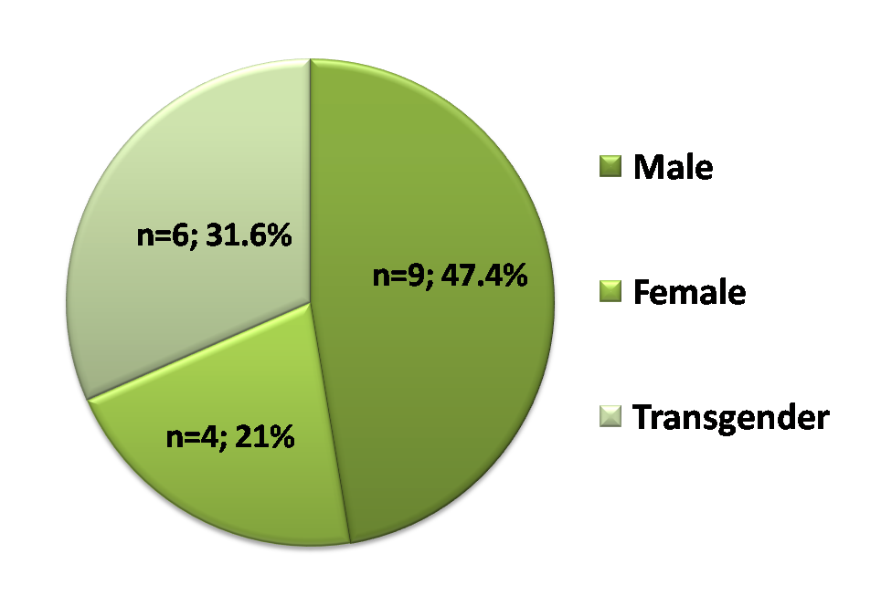
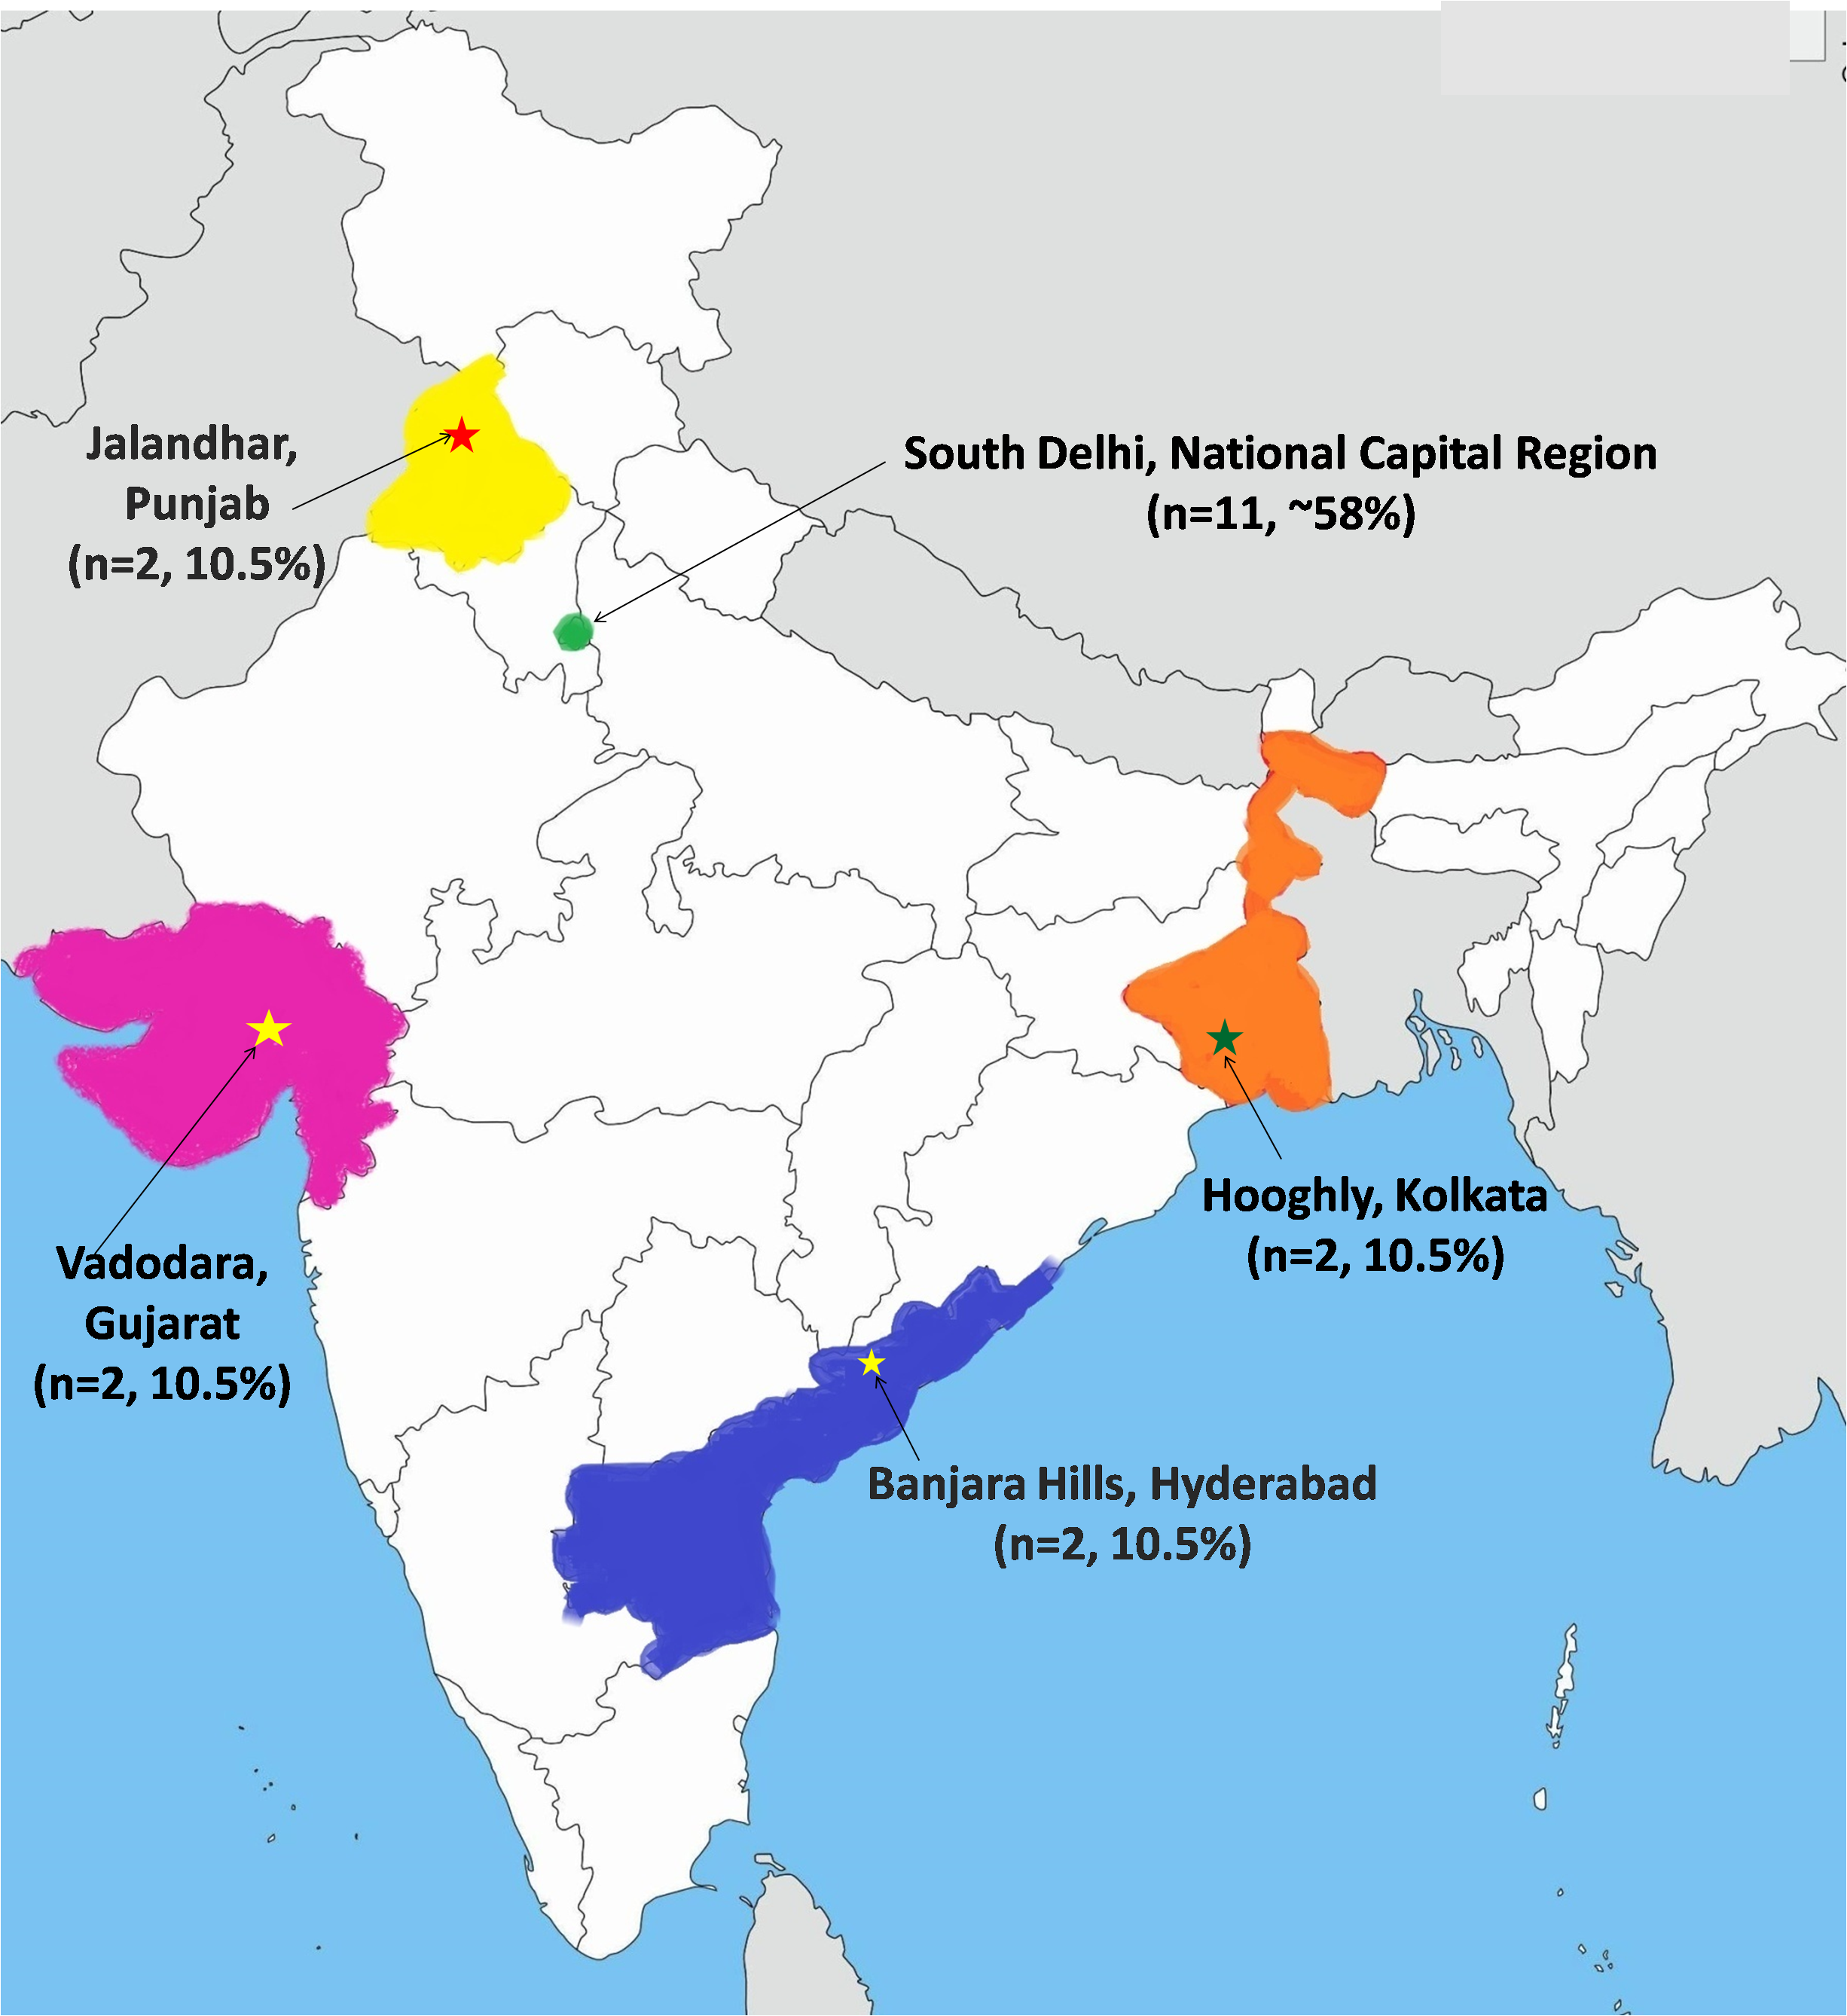
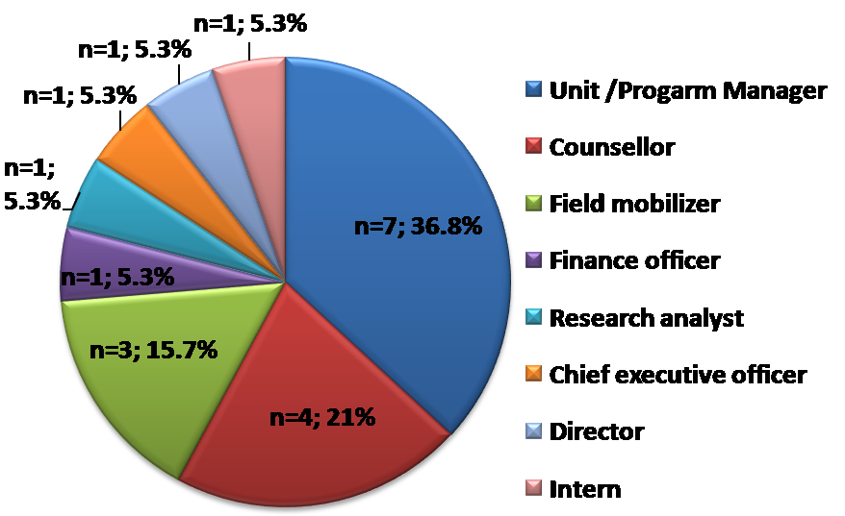
(a)
(b)
(c)

Slide 2
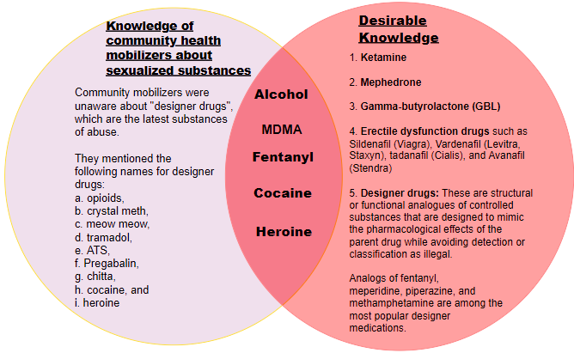
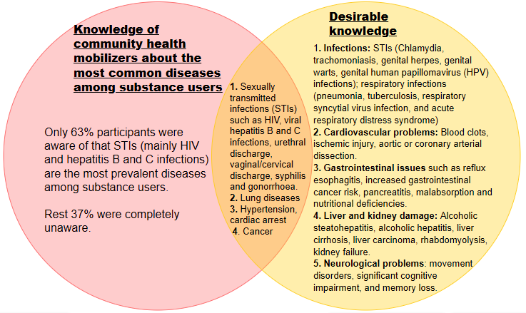
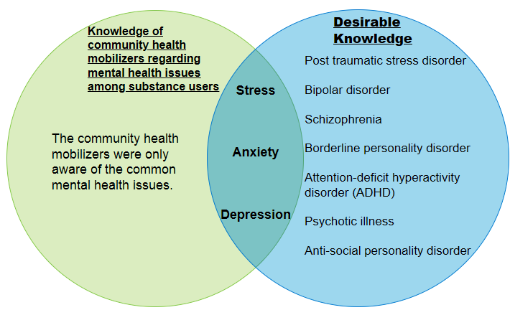
(a)
(a)
(b)
(c)

Slide 3
In-depth interviews of the community health mobilizers (n=19)
Thematic content analysis
Knowledge
Attitude
Practice
Sexualized substance use: types of substances, health problems, methods of consumption and procurement, and designer drugs
Role of religion and spirituality in substance use
Effect of substance use on quality of life
Harm reduction guide
Drug overdose related first aid procedures
Major Probes
Alcohol, methamphetamine, ATS, Avil, afeem, heroine, poppers, ganja, and cocaine- most common substances.
STIs, RTIs, cancer, and lung diseases-most common diseases among drug users.
Injecting, sniffing, oral, sublingual, and smoking- methods of using substances.
Peddlers, pan shops, community friends, sexual parties, medical stores, and liquor shops- sources of getting substances.
Opioids, fentanyl, LSD, meow meow, crystalmeth, tramadol, ATS, chitta, cocaine, and heroin - designer drugs.
Engaging in spiritual and religious pursuits, such as yoga and meditation, can aid in the recovery from substance use.
Drug abuse leads to job losses, financial struggles, health problems like STIs, hypertension, cardiac arrest, and quarrels with family, social isolation.
The community mobilizers had basic understanding of harm reduction, which they shared with their clients during counselling.
Individuals who have overdosed on drugs should be given naloxone injection, water with ORS or glucose.
Individuals who are severely ill may be shifted to a nearest hospital which is 15-20 minutes far from the workplace of community mobilizers.
Responses
A knowledge gap was observed in the community mobilizers:
Lack of awareness about various drugs used for chemsex (ketamine, erectile dysfunction drugs etc.) and latest substance of abuse such as designer drugs.
Lack of knowledge about online sources for drug procurement.
Poor knowledge about STIs, and additional health and psychological illnesses associated with sexualized substance use.
Lack of awareness about prophylactic medications for HIV/AIDS.
Recommendations:
Community health mobilizers need to broaden knowledge regarding latest substances of abuse, online drug procurement sources, various health and psychological issues associated with substance use.
Findings should be validated through community-based research across the country.
Individuals who engage in SSU should be included in preventive and educational programs to lower the frequency of high-risk sexual practices and STIs.
Gap analysis

