Slide 1
Figure 1
Number of records identified through database searching:
120.000.000
Number of records identified through other databases outside selected :
1.800.000
Identification
Screening
Number of duplicates removed: 6,350.000
Number of papers excluded with reason :
1118
Number of papers screened to fit search criteria :
1800
Eligibility
Papers eligible to include in paper:
191
Included

Slide 2
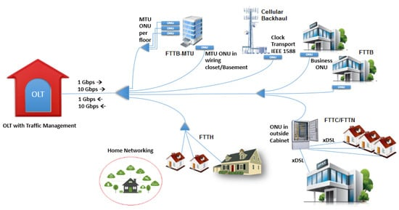
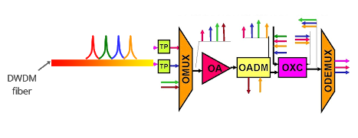
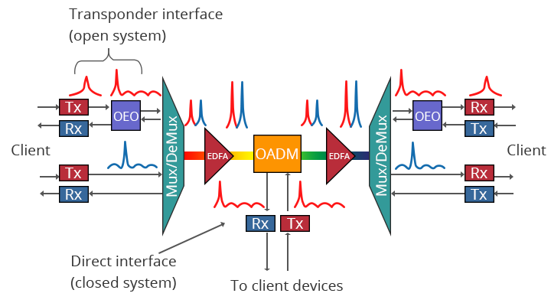
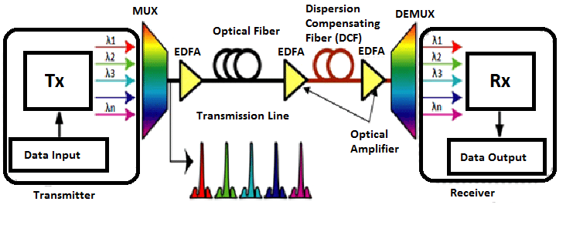
Figure 2
OPTICAL NETWORKS = DWDM+ROADM+PON
DWDM +OADM+OXC
DWDM + OADM
DWDM
Point to point transmission

Slide 3
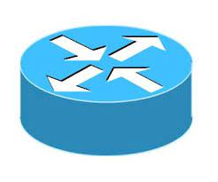
Figure 3
SDN APPLICATIONS
APPLICATION PLANE
BUSINESS APPLICATIONS
CLOUD ORCHESTRATION
NORTH BOUND API
TRAFFIC ENGINEERING
ROUTING
SWITCHING AND MOBILITY
PCE
DB
CONTROL PLANE
SDN CONTROLLER
SOUTH BOUND API
NETWORK ELEMENTS
OPENFLOW SWITCH
OPENFLOW SWITCH
USING OPENFLOW PROTOCOL
DATA PLANE
END USERS

Slide 4
Figure 4
GLOBAL NETWORK TOPOLOGY
SDN controller
Source
OpenFlow Devices
Destination

Slide 5
Figure 5
VNFs
Data Flow
VNFs
Customer Site
Data Center
Customer Network
Transport
Network
vCPE

Slide 6
Figure 6
Application layer
SERVICE
OpenSDWN Controller
Middlebox Driver
Radio Driver
Cross-layer
Orchestrator
Controller layer
VAP May
Neutron
(Ryu Controller)
Nova
Middlebox server
VAP Bob
Physical AP 1
Migration
Infrasturature layer
VAP Bob
Physical AP 2

Slide 7
Figure 7
AUTO CONFIGURATION &
AGILITY
COST EFFECTIVE
Benefits of SDN
EASY
MANAGEMENT
CENTRALISED CONTROL

Slide 8
Figure 8
ORCHESTRATION PLANE
SDN ORCHESTATOR
…………
PCE
DB
CONTROL PLANE
SDN CONTROLLER
SDN CONTROLLER
VM 1
REST
PCEP
REST
VM 1
VM 1
VM 1
VM N
host 1
AS-PCE
VM N
ovs
OPENFLOW SWITCH
GMPLS
GMPLS
GMPLS
ovs
GMPLS
DATA PLANE
VM 1
OFS
OFS
VM 1
OFS
VM 1
OFS
VM 1
VM N
OFS
OFS
ETHERNET
VM N
ovs
ETHERNET
ovs
Network elements

Slide 9
Figure 9
MANAGEMENT PLANE
(Operation and network administration .etc.
CONTROL PLANE
(Adaptability ,switching controls ,RWA Network elements etc.
DATA PLANE
(data transmission ,routing ,data processing etc.

Slide 10
Figure 10
Native GUI/CLI (NBI)
OSS/ BSS
REST
REST(NBI)
Docker commands
NETCONF(SBI)
Callbacks
Agent 2
Agent 1
Agent N
Pool of agents

Slide 11
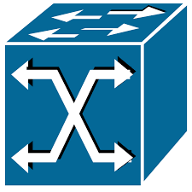
Figure 11
SDN CONTROLLER
PROTOCOL
PROTOCOL
OPENFLOW
SWITCH 1
OPENFLOWOPTICAL
OPENFLOW OPTICAL
OPENFLOW
SWITCH 2
CONVERTOR
OPENFLOW OPTICAL
ROADM1
ROADM3
CLIENT1
CLIENT2
ROADM2

Slide 12
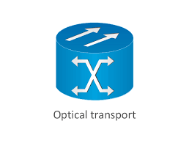
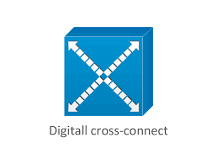
Figure 12
Application
Plane
bBandwidth on Demand
Spectrum Defragmentation
Virtual Network Provision
Virtual Resource Migration
Northbound interface ( CVNI)
Father
Controller
Sparse Topology Manager
Virtual Topology Manager
Sparse Route Calculation
Controller Core
Southbound interface ( CVNI)
Domain
Controller
Topology Manager
Path Calculation
Network Virtualize
Device Database
Controller Core
Data Plane
Southbound interface ( OpenFlow)
Data Center
ROADM

Slide 13
Figure 13
SDN Controller
Virtual Network Slice
Physical Optical Network

Slide 14
Figure 14
ONOS
Management
Plane
Netconf Client
Netopeer 2
Netconf Server
Sysrepo Client Library
Unix Domain Socket
Device & Resource abstraction Layer
YANGS
Filesystem
Sysrepo Engine
Sysrepo
Data Files
C-Code Plugin
Unix Domain Socket
Plugin
Plugin
Plugin
Operational
Plane
Power meter
Laser
Attenuator

Slide 15
NBI optical planning tool
Figure 15
RESTful API
SDN CONTROLLER
Driver
Driver
NETCONF protocol
OpenConfig based agent
OpenConfig based agent
TX
RX

Slide 16
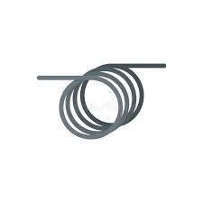
Figure 16
Agent
Agent
Agent
Agent
Agent
Agent
Agent
Agent
100G
RX
A
100G
RX
B
40ch COMB TX
COMB RX 2
COMB RX 3
100G
RX
A
100G
RX
B
40
3
40
Agent
Agent
Agent
Agent
BV
WSS
Agent
BV
WSS
BV
WSS
BV
WSS
80km
80km
VOA
E1
E2
E3
E4
VOA
mon
mon
ROADM 1
ROADM 3
Agent
OSA
ROADM 2

Slide 17
Figure 17
1
T-API service
Connectivity request
T-API
1b
NETCONF
RESTCONF
OTDN app
ONOS services
Optical intent
2
Planning and Impairments tools
1a
1c
Paths
Impairment
Device features
Selected path
Device configuration
(a)
NETCONF
RESTCONF
3
ODTN drivers
1
3
2

Slide 18
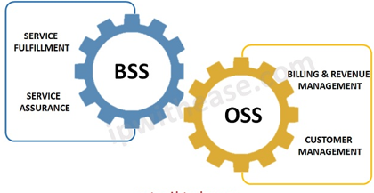
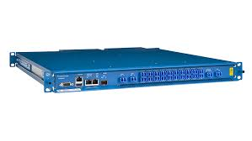
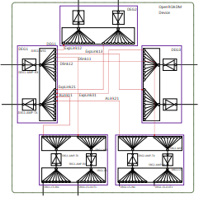
Figure 18
APPS
T-API
Kubernetes orchestration
Dockerised
NBI
NETWORK ORCHESTRATION PLANE
ATOMIX CLUSTER
YANG MODELS
ONOS SDN CONTROLLERS
Netconf
SDN AGENT
SDN AGENT
DRIVERS
YANG MODELS
YANG MODELS
SBI
DATA PLANE
ROADMS
transponders

