Slide 1
Supplementary data
Title: Delineating the tissue-mediated drought stress governed tuning of conserved miR408 and its targets in rice
Sonia Balyan, Shivani Kansal, Ringyao Jajo, Pratyush Rajiv Behere, Rishika Chatterjee and Saurabh Raghuvanshi*
All Author Affiliations:
Department of Plant Molecular Biology, University of Delhi South Campus
New Delhi 110021, India
*Corresponding author:
Dr. Saurabh Raghuvanshi
Professor
Department of Plant Molecular Biology, University of Delhi South Campus
New Delhi 110021
Email: saurabh@genomeindia.org
Phone: +91 9811574152

Slide 2
a
b
Figure S1. The phylogenetic conservation of miR408 family in plants. (a) The conservation of miR408 across diverse plant species adapted from database PmiREN. The species highlighted in green have annotated miR408. (b) The sequence comparison of annotated miR408 in different plant species (n=97). The differences are highlighted in pink color. The conservation is depicted as bars and consensus logo.

Slide 3
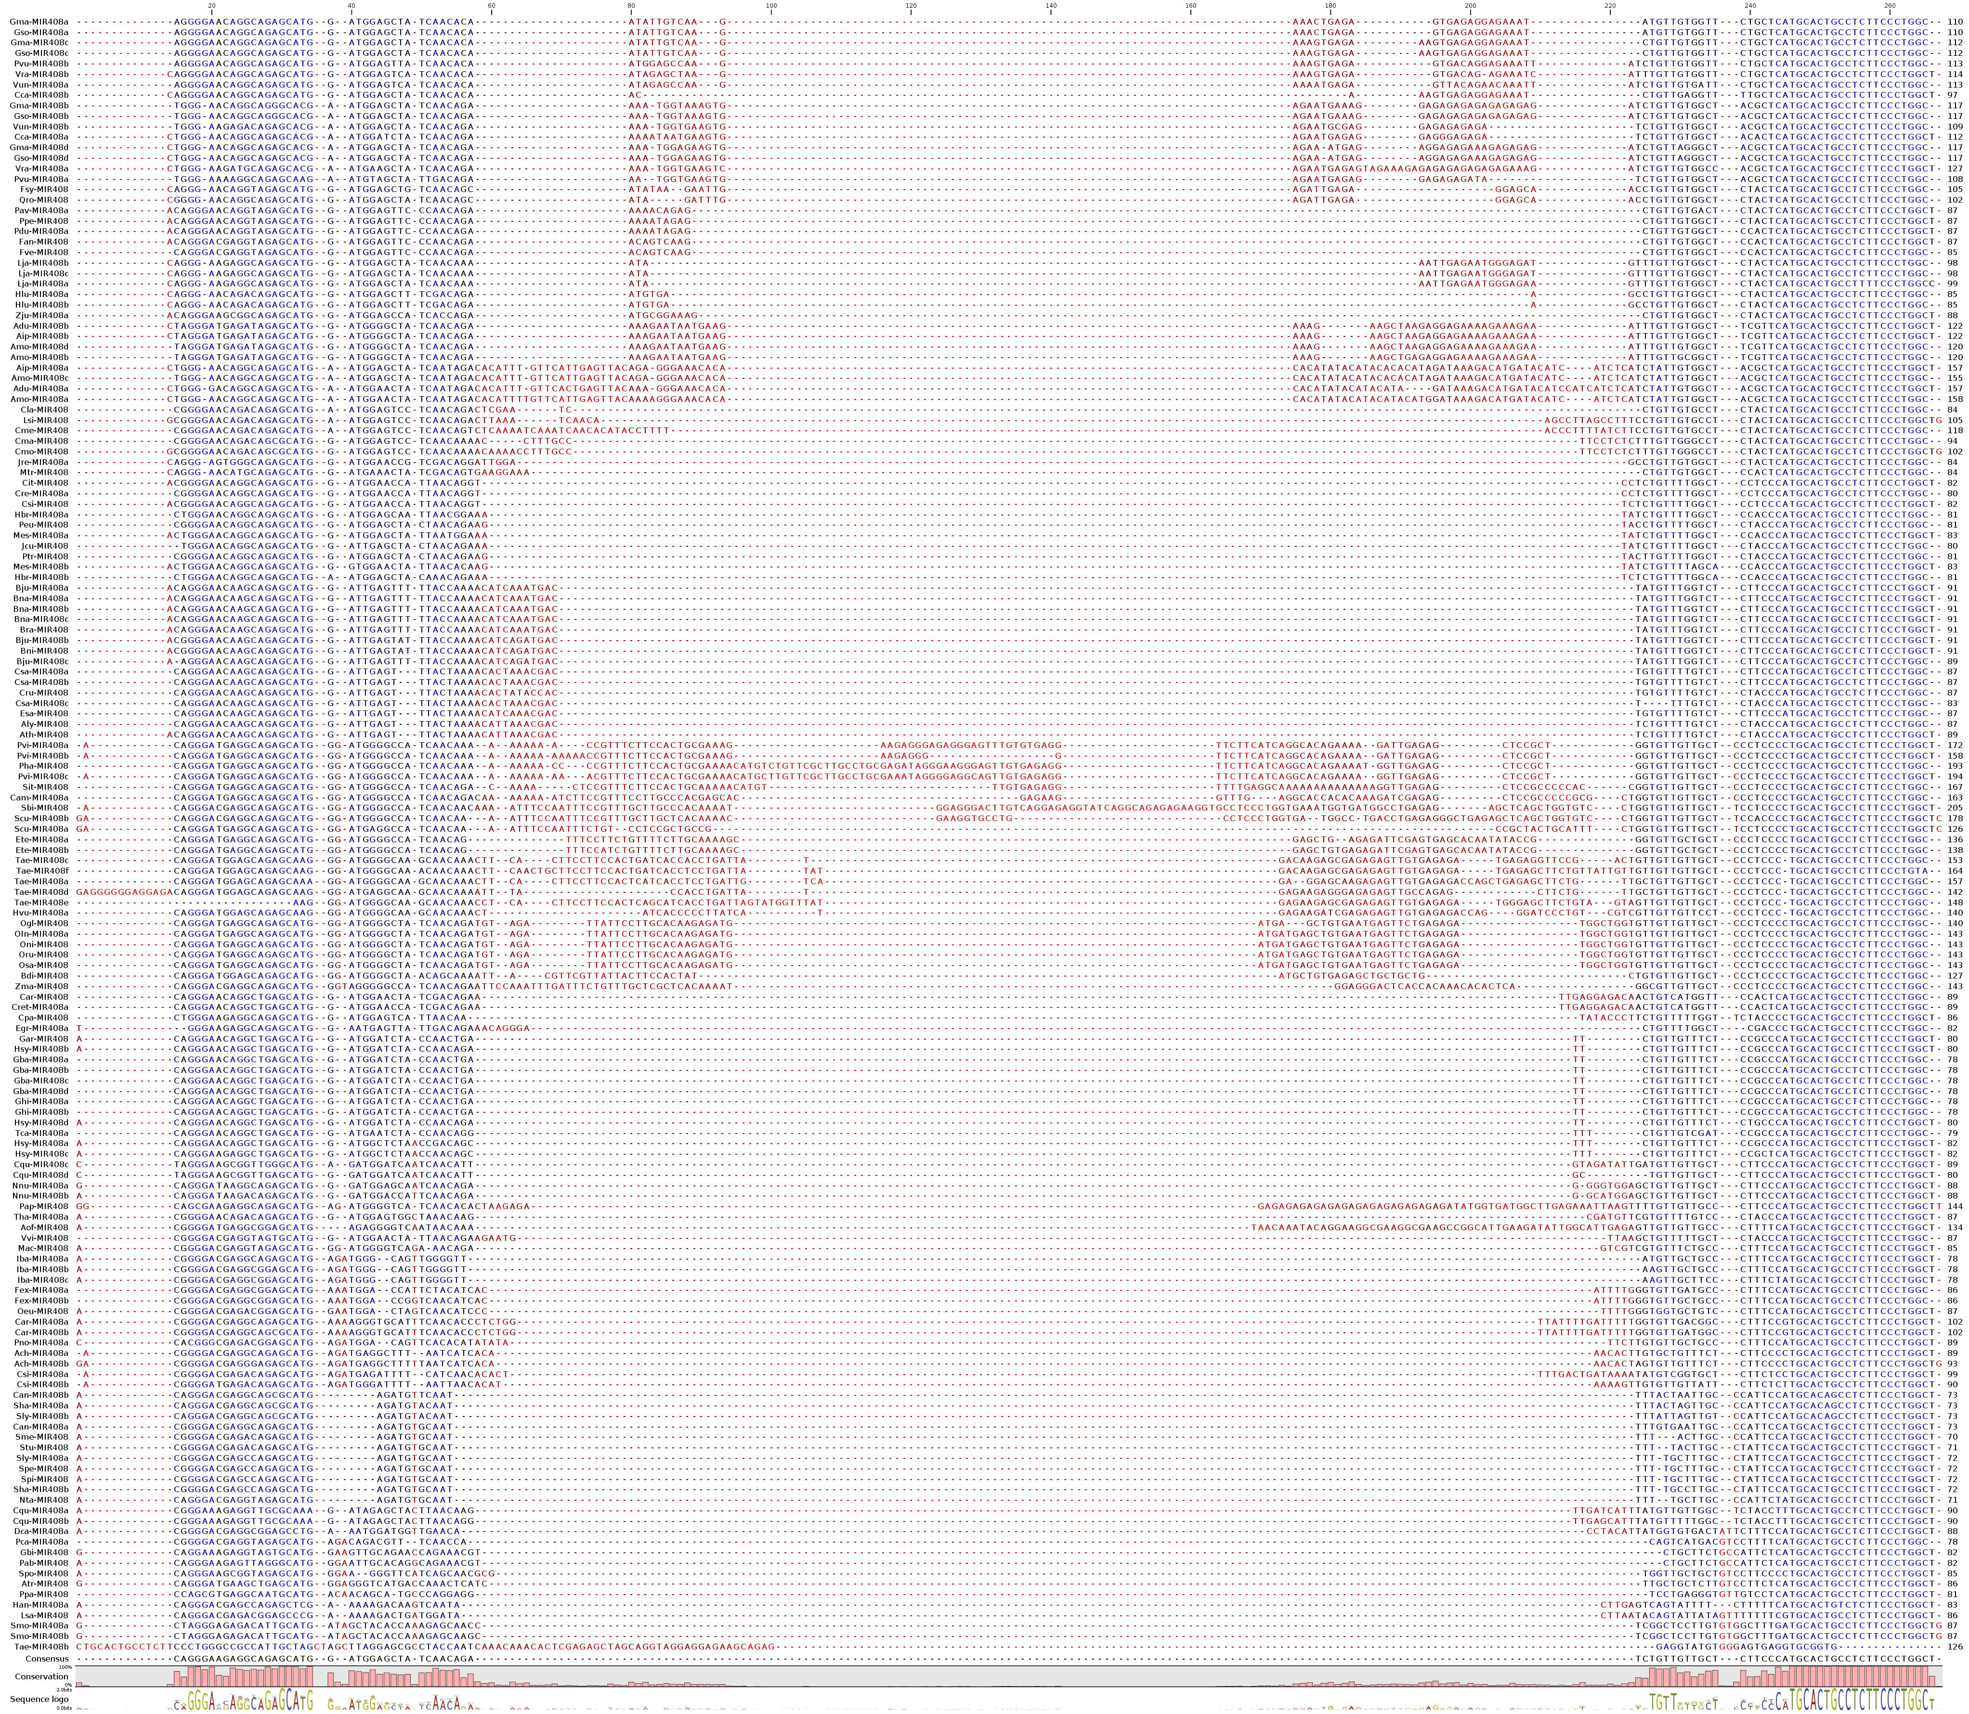
miR408-5p (star)
miR408-3p (mature)
Figure S2. The sequence alignment of MIR408 in plants. The sequence comparison of annotated MIR408 in different plant species using alignment tool of CLC genomics (version 9). The conservation and differences or gaps are highlighted in blue and pink color respectively.

Slide 4
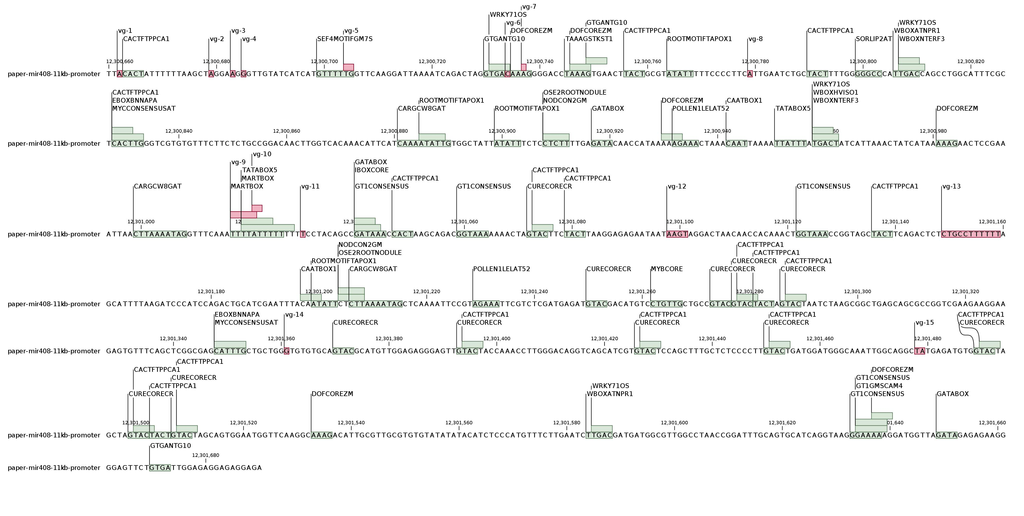
Figure S3. Mapping of variants and cis-elements on MIR408 promoter sequence. The 1kb promoter region showing the position and overlap of variants (highlighted in red color) detected in 4726 rice accessions with the different cis-regulatory elements (highlighted in green color) detected in promoter using New Place database.

Slide 5
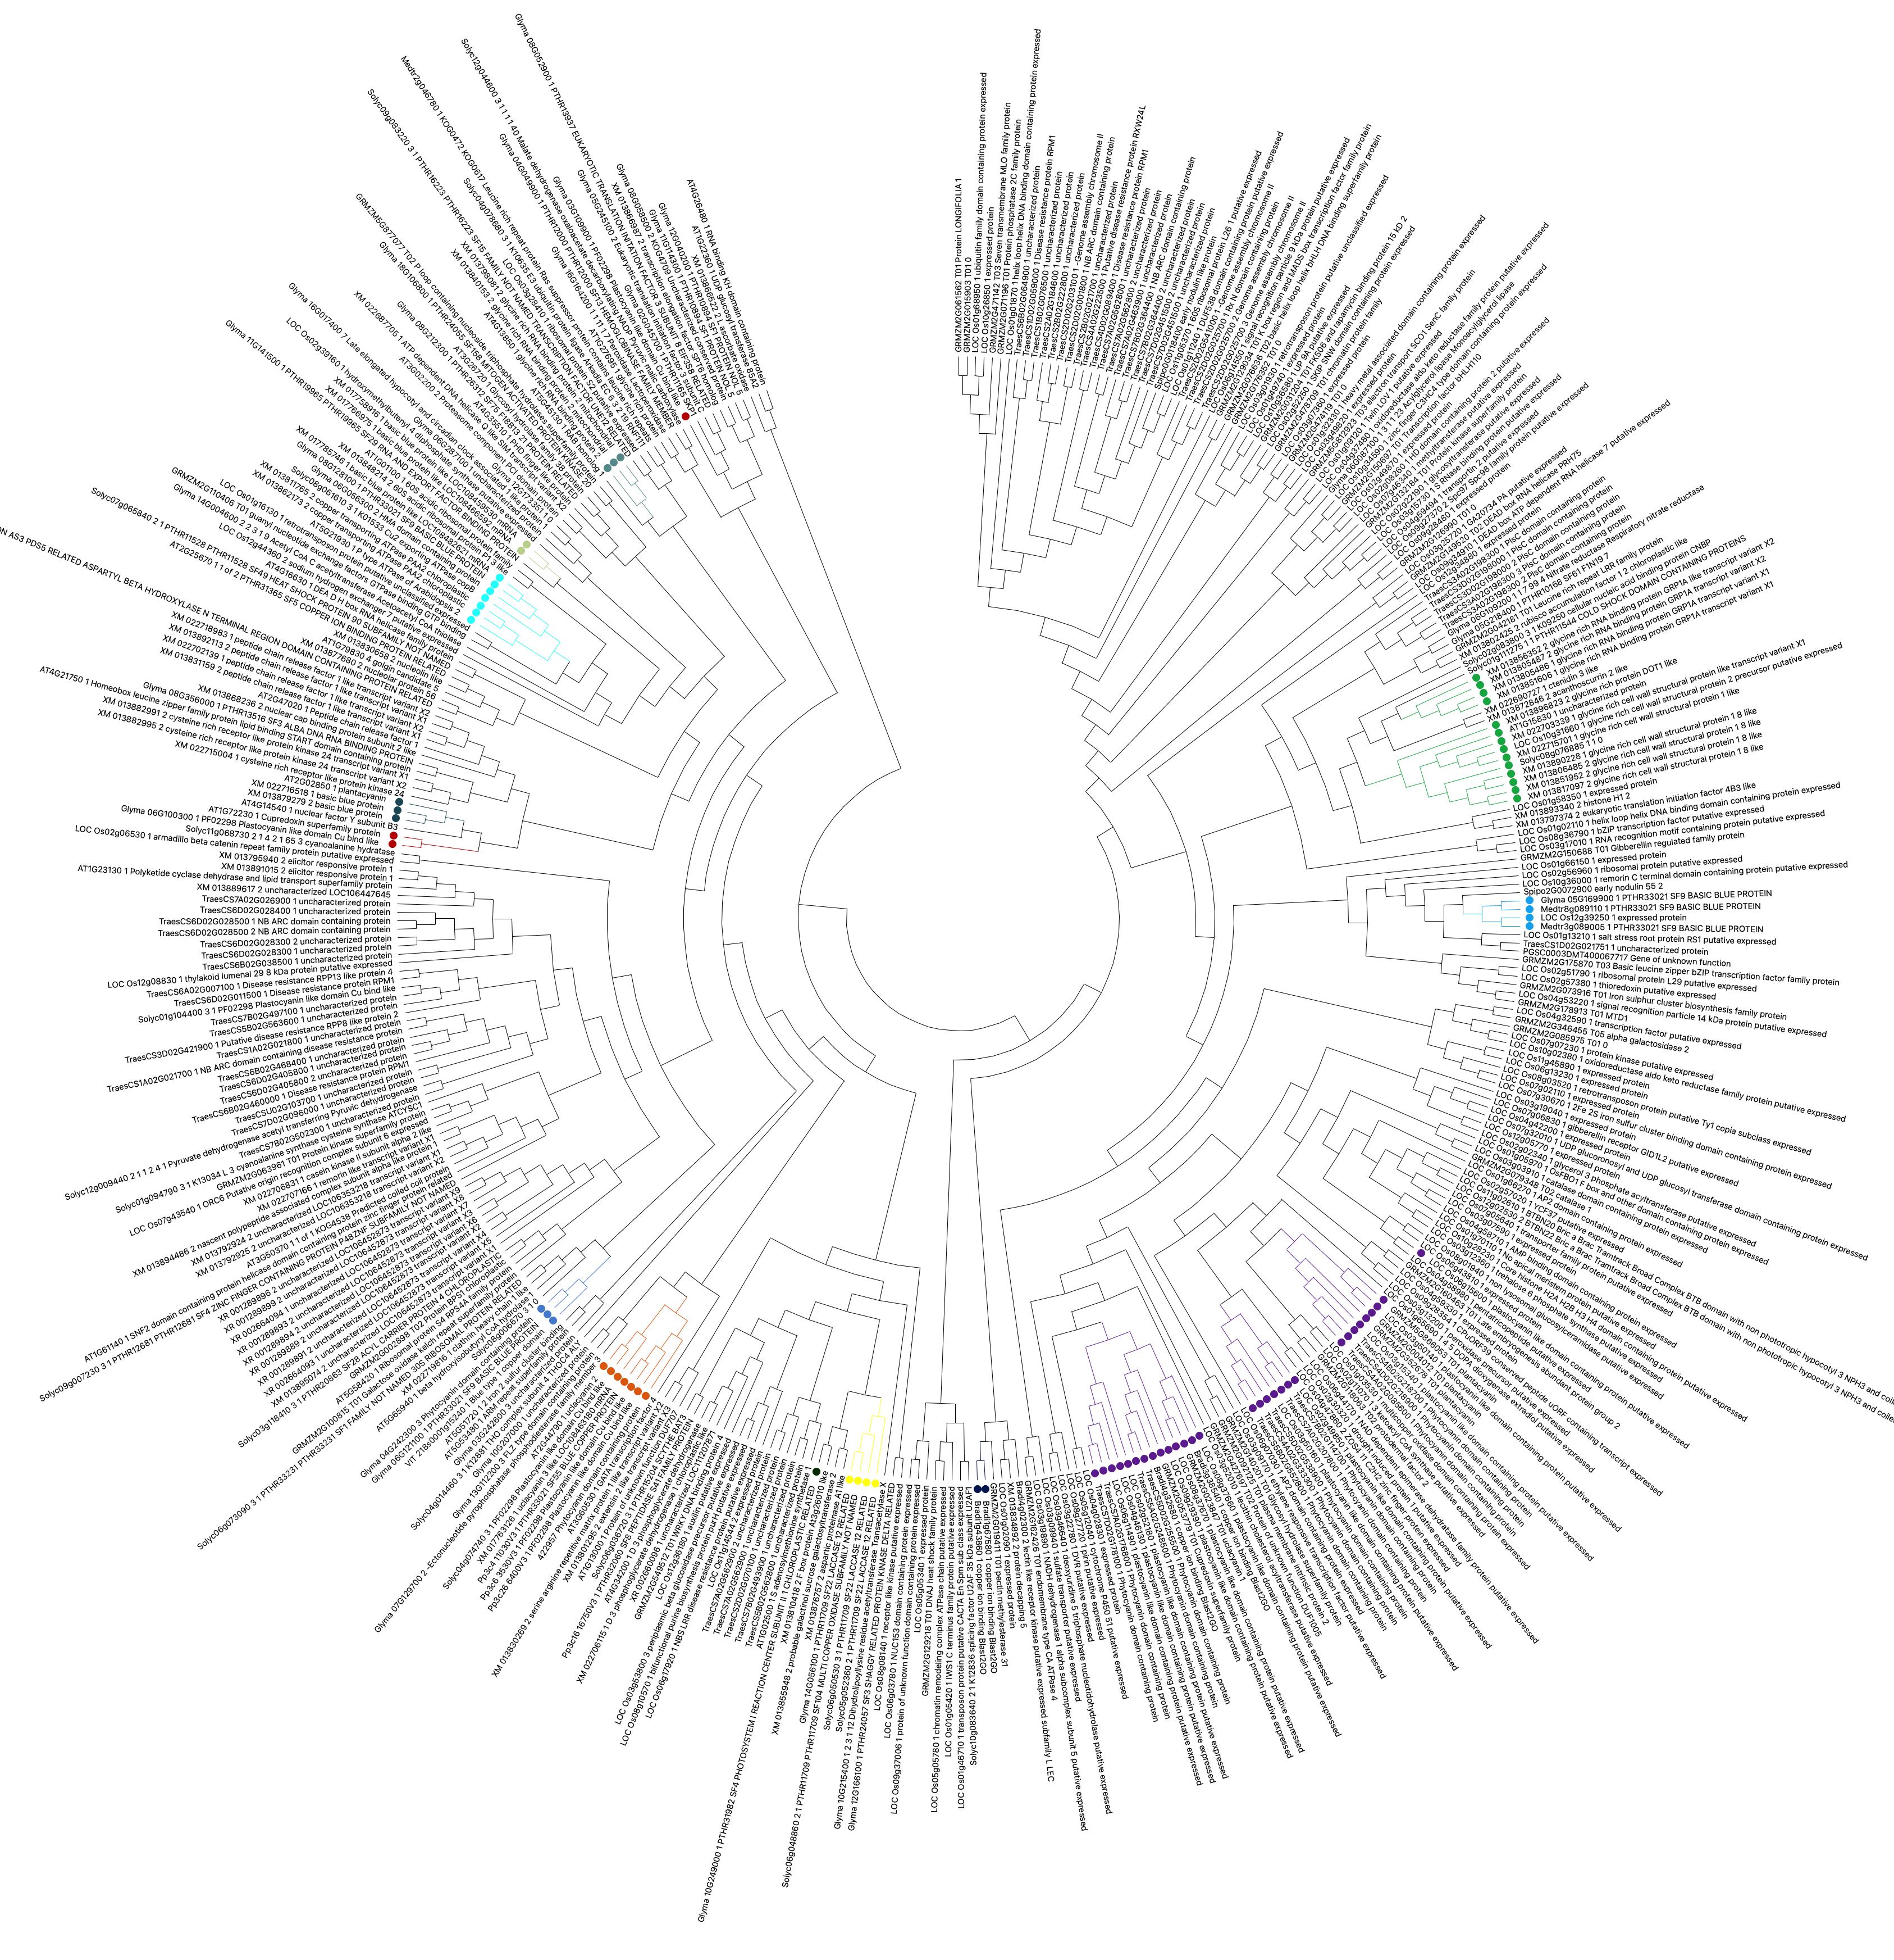
Figure S4. The phylogenetic tree showing the conservation of miR408 targets. The degradome identified targets were extracted from PmiREN database for 13 diverse species and analyzed following the PhyML 3.0. The conserved target families were highlighted in different colors.

Slide 6
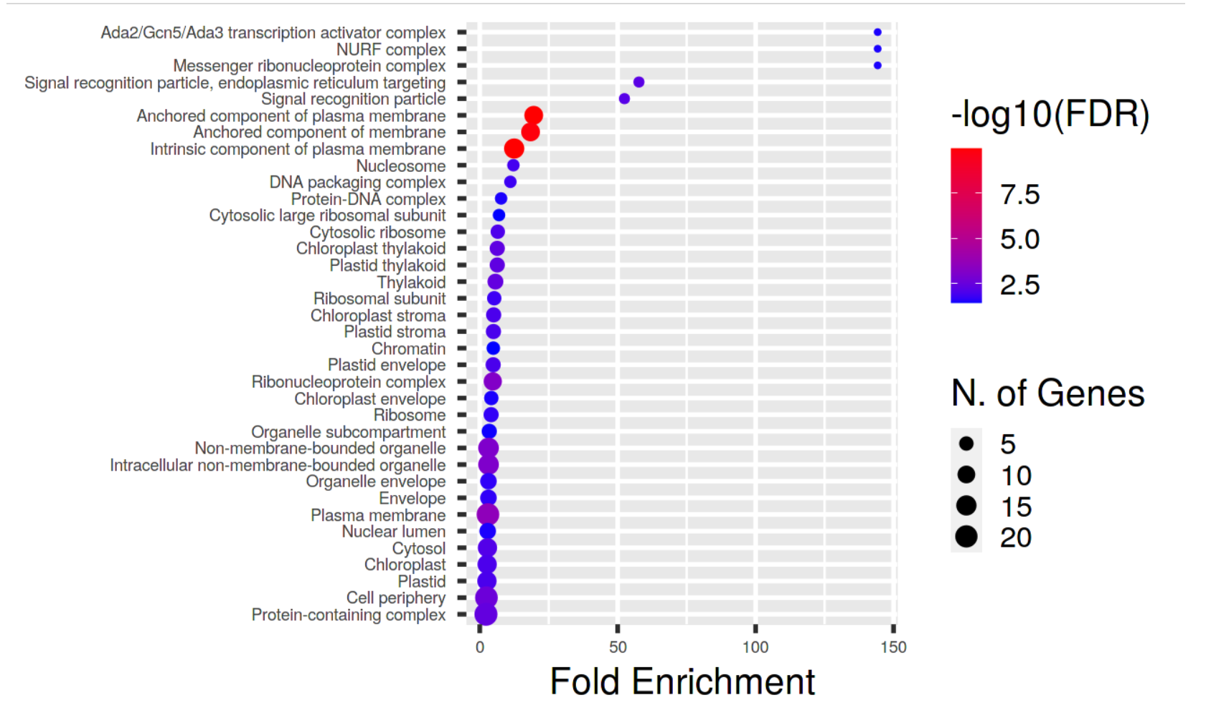
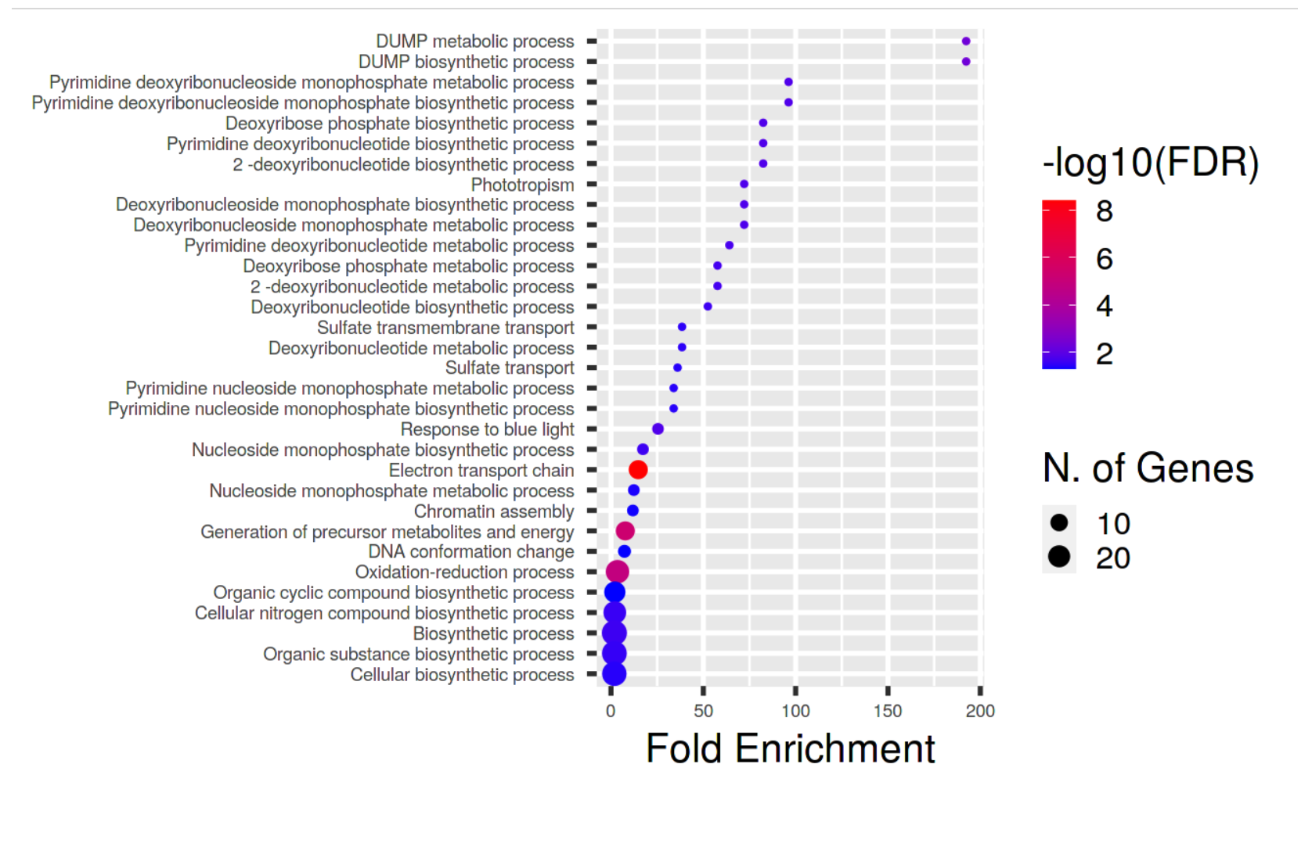
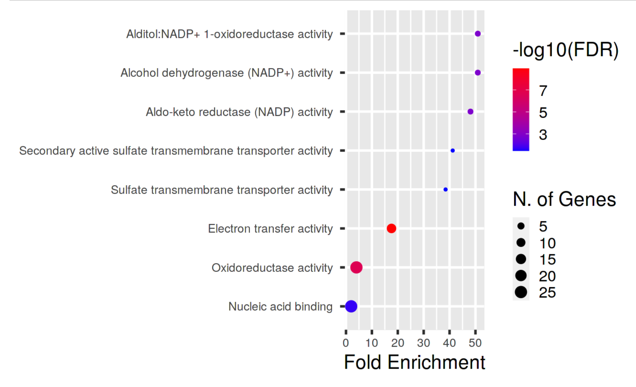
a
d
b
c
INF
FL
RT
Figure S5. Gene ontology and pathway enrichment of miR408-3p targets in rice. (a-c) GO enrichment analysis of miR408-3p targets in rice using ShyniGO tool showing the enriched terms belonging to cellular component (a), biological process (b) and molecular function (c). The terms with significant enrichment with P-value ≤ 0.05 were shown. (d) The expression of miR408-3p targets in flag leaf, inflorescence and root at heading stage of development. The genes marked with green, black and red dots represents the tissue enrichment ≥ 5 in flag leaf, root and inflorescence. The heat map was generated using the fold-enrichment fold change using clustvis online tool following Euclidean distance and complete linkage with unit variance scaling is applied to rows.

Slide 7
Table S6. The comparative summary of regulation of miR408-3p/target in N22 and MIR408-OE overexpression. The detailed expression correlation of miR408-3p targets under drought in flag leaf and root, expression in root w.r.t. flag leaf and in MIR408-OE seedlings. The category and PARE datasets represents the evidence from degradome. The inverse trend in expression of miR408 and its target transcript was represented by * (strength).

Slide 8
a
b
c
d
e
Figure S7. The morphometric characterization of different MIR408-OE-lines in T1 generation. (a) Morphometric comparison of wild type PB1 with four MIR408-OX-lines (1, 3,12 and 16); (b) qRT-PCR validation of miR408-3p in different transgenic overexpression lines. 5s is used as the endogenous control and two biological and three technical repeats were analyzed for each line. (c-e) Box plots represents the comparison of seedling weight, Shoot length and Root length of WT and MIR408-OE lines. Each value represents the mean of at least 10 plants.

