Slide 1
A
B
C
D
Supplementary file 1. IC50 dose-response curves for T. gondii tachyzoites grown in HFF treated with DCQ (A), RMB054 (B), RMB055 (C) and RMB060 (D). Compounds were either added prior or 3h after infection with Tg-β-gal.

Slide 2
A
B
Supplementary file 2. T. gondii IgG antibody titers of non-pregnant mice (A) and dams (B) measured from serum collected at the end of the experiment. Results are depicted as the mean of RIPC (relative index per cent) compared to the positive control (C+). In non-pregnant mice and dams, no statistically significant differences in the IgG antibody titers were observed between DCQ-treated mice compared to the C+ group.

Slide 3
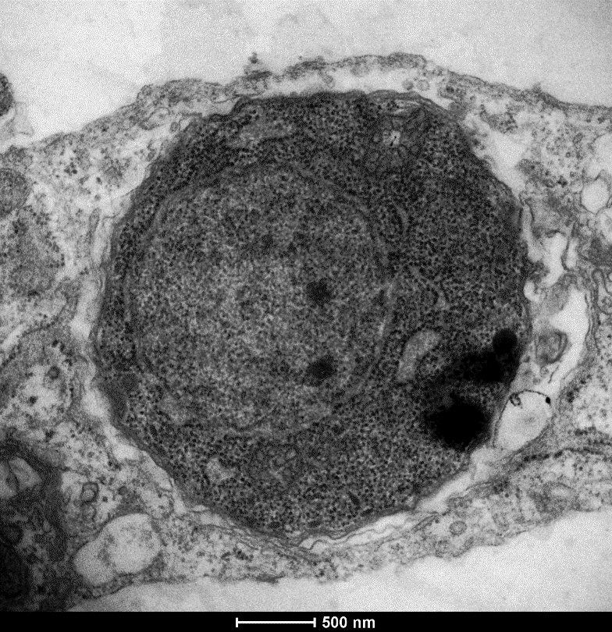
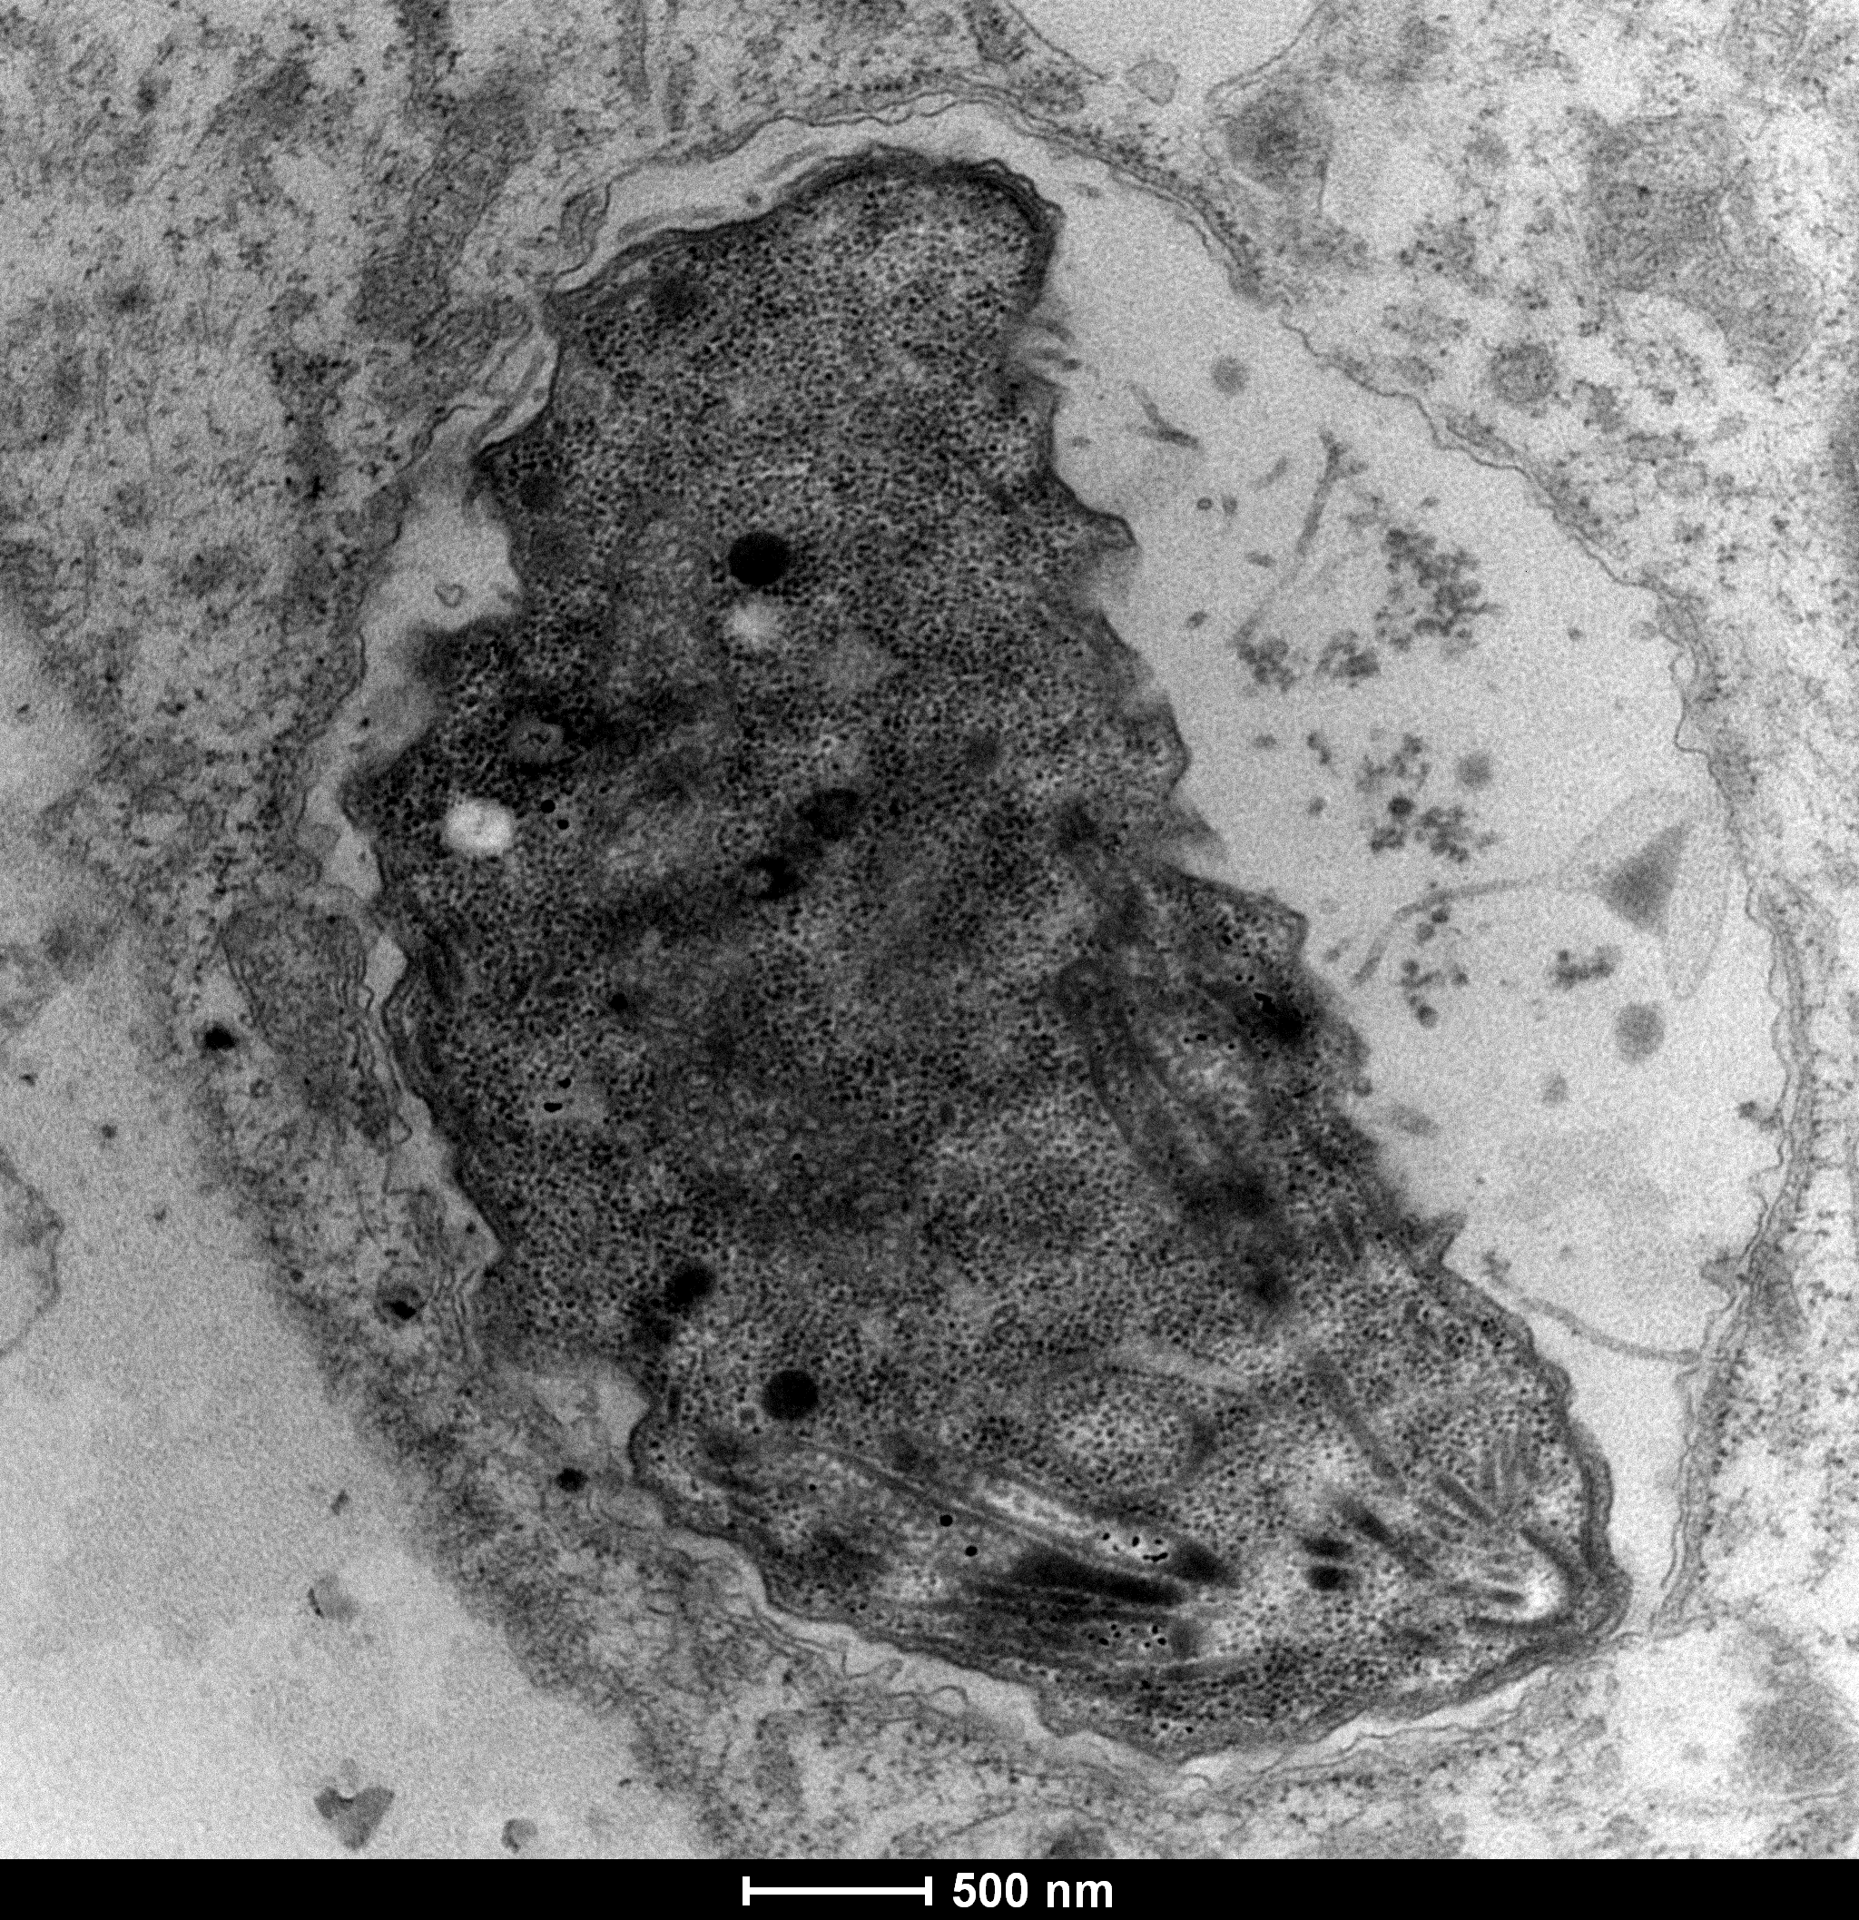
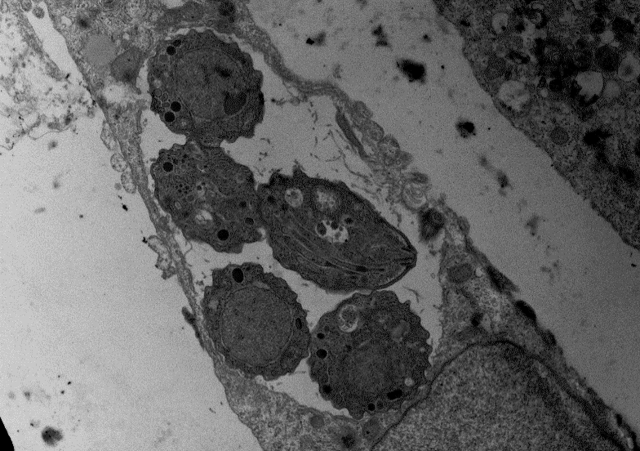
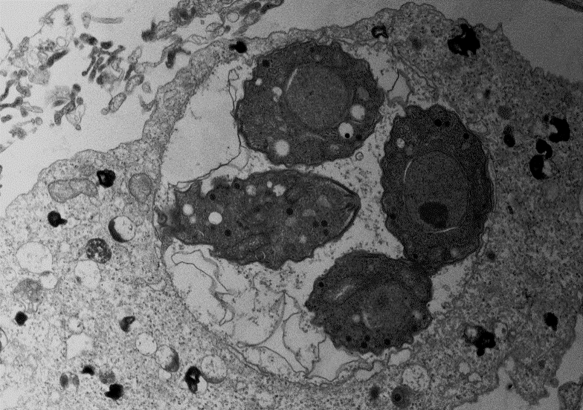
A
B
mito
dg
PVM
n
PVM
mito
rhop
dg
mic
mito
rhop
con
C
dg
D
rhop
rhop
n
PVM
PVM
n
con
dg
mito
mito
dg
dg
rhop
mito
mito
rhop
mito
dg
vac
vac
con
n
dg
rhop
mic
con
mito
dg
mito
n
mito
mito
dg
n
n
mito
dg
dg
hnuc
Supplementary file 3, Figure 1. TEM of T. gondii Me49 tachyzoites cultured in vitro in HFF host cells. HFF monolayers were infected with T. gondii tachyzoites and drug treatment was initiated 3h later. TgMe49 treated with 0.5 µM DCQ for 6h are shown in (A), 24h in (B), 48h in (C) and 72h in (D). con = conoid; dg = dense granules; mic = micronemes; mito = mitochondrion; n = nucleus; hnuc = host cell nucleus; PVM = parasitophorous vacuole membrane; rhop = rhoptries; vac = cytoplasmic vacuole. Bars in (A) = 0.4 µm; (B) = 0.4 µm; (C) = 2.2 µm; (D) = 1.8 µm.

Slide 4
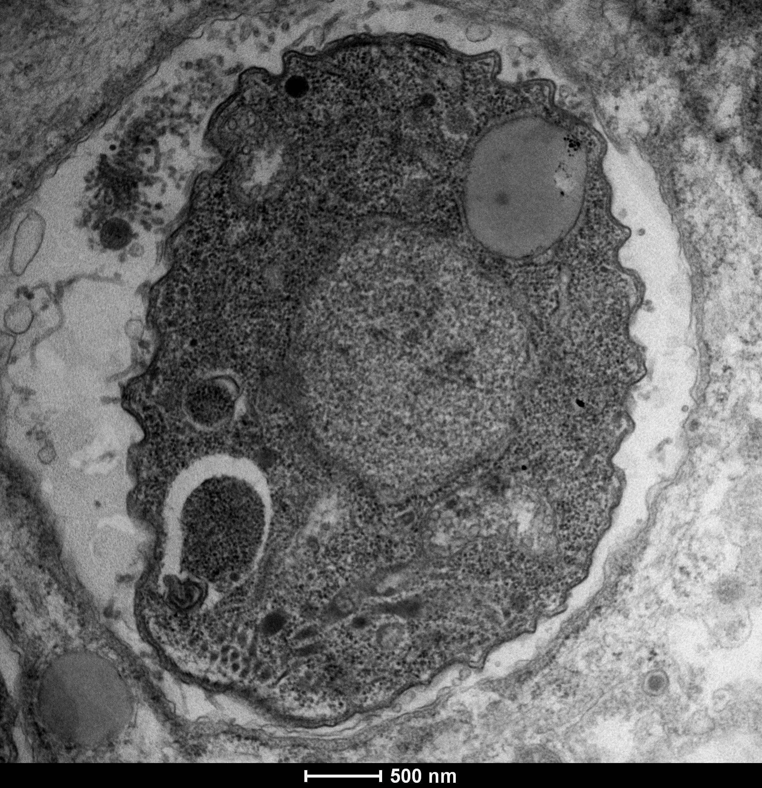
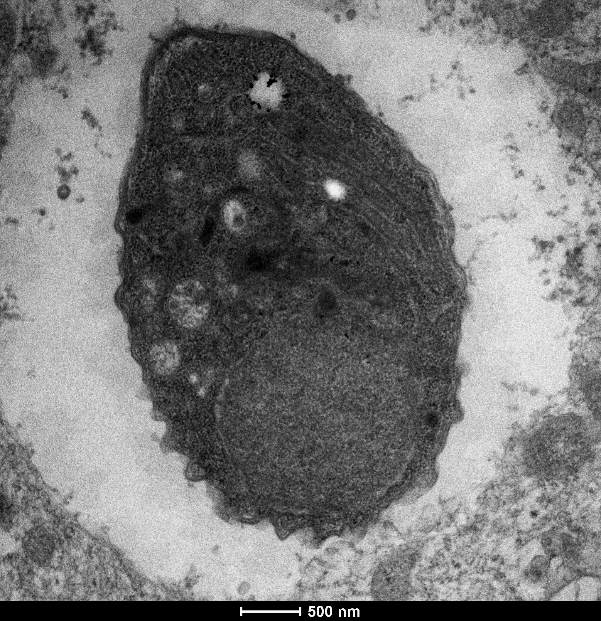
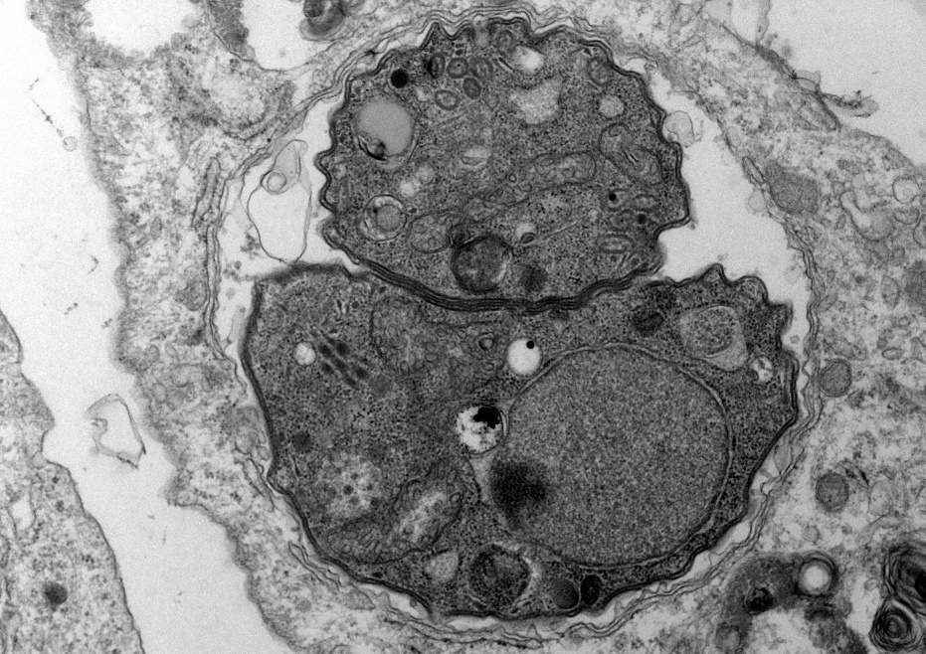
A
dg
B
PVM
ld
dg
mito
n
mito
n
mito
mito
rhop
dg
rhop
mic
PVM
con
C
con
D
dg
rhop
ld
mito
rhop
PVM
mito
rhop
mito
n
mito
vac
n
PVM
dg
Supplementary file 3, Figure 2. TEM of T. gondii Me49 tachyzoites cultured in vitro in HFF host cells. HFF monolayers were infected with T. gondii tachyzoites and drug treatment was initiated 3h later. TgMe49 treated with 0.5 µM RMB054 for 6h are shown in (A), 24h in (B), 48h in (C) and 72h in (D). con = conoid; dg = dense granules; ld = lipid droplet; mic = micronemes; mito = mitochondrion; n = nucleus; PVM = parasitophorous vacuole membrane; rhop = rhoptries; vac = cytoplasmic vacuole. Bars in (A) = 0.4 µm; (B) = 0.4 µm; (C) = 0.6 µm; (D) = 0.6 µm.

Slide 5
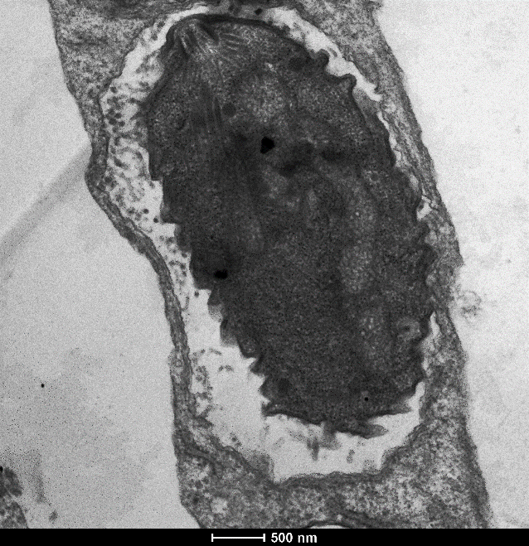
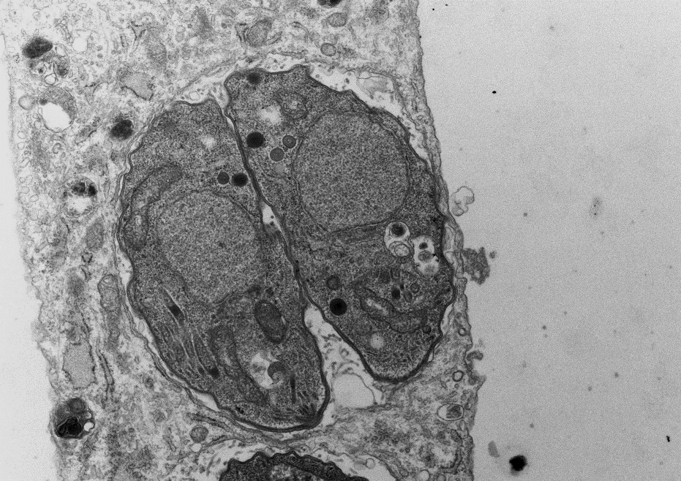
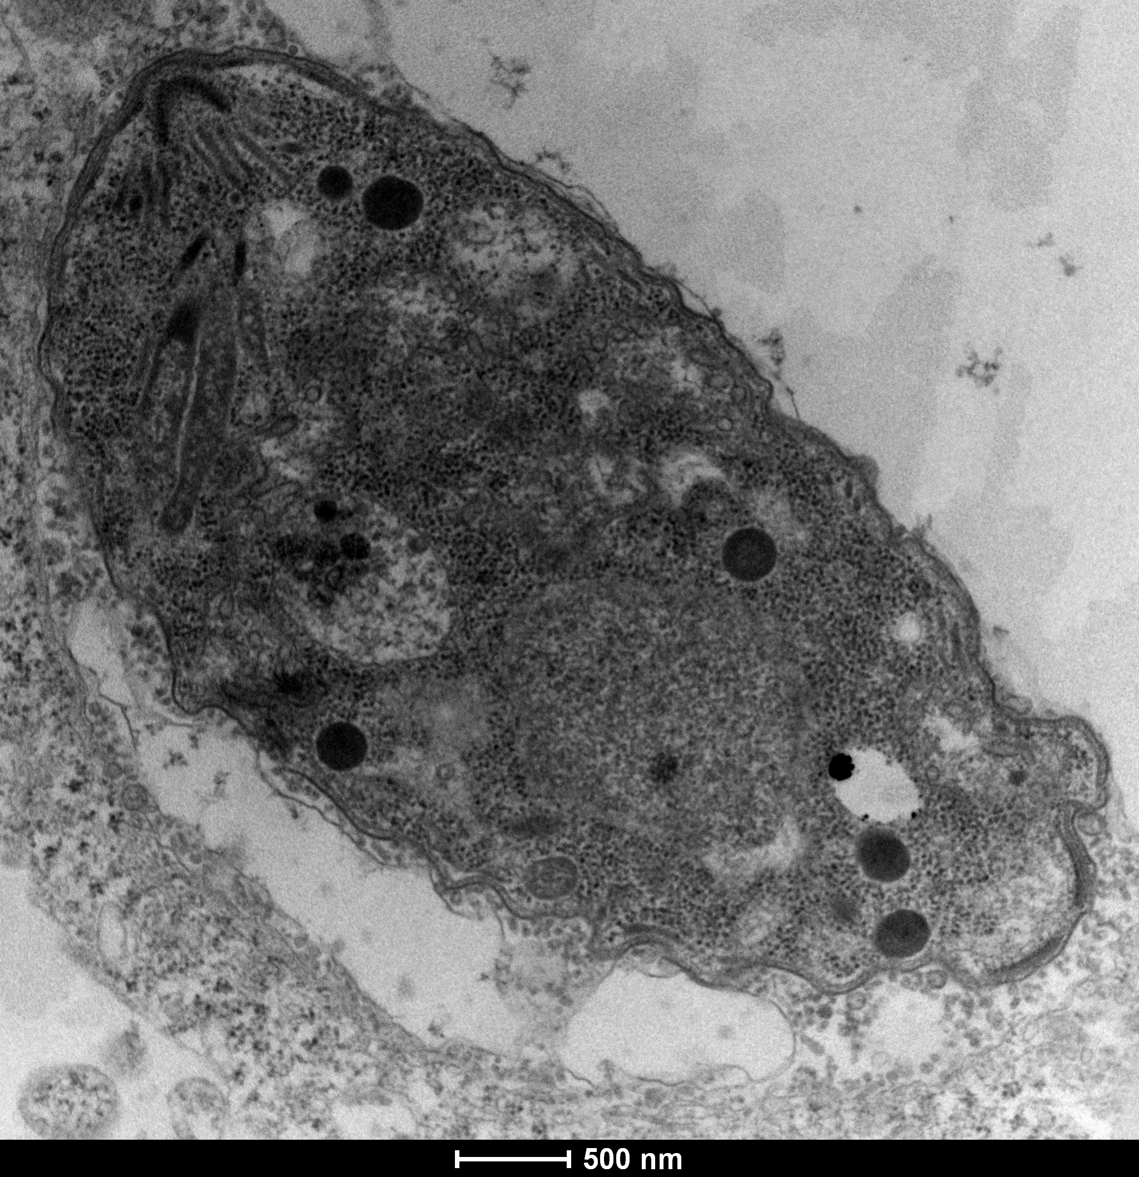
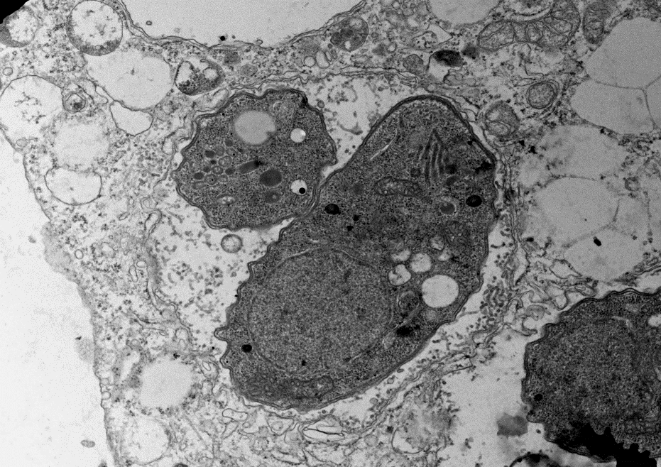
A
con
dg
B
mic
PVM
mito
dg
mito
rhop
mito
dg
dg
n
mito
hmito
n
rhop
mito
dg
dg
mito
mic
PVM
con
con
C
D
mic
dg
PVM
rhop
mito
ld
rhop
dg
dg
mito
dg
n
n
vac
vac
PVM
dg
mito
Supplementary file 3, Figure 3. TEM of T. gondii Me49 tachyzoites cultured in vitro in HFF host cells. HFF monolayers were infected with T. gondii tachyzoites and drug treatment was initiated 3h later. TgMe49 treated with 1 µM RMB055 for 6h are shown in (A), 24h in (B), 48h in (C) and 72h in (D). con = conoid; dg = dense granules; ld = lipid droplet; mic = micronemes; mito = mitochondrion; hmito = host cell mitochondrion; n = nucleus; PVM = parasitophorous vacuole membrane; rhop = rhoptries; vac = cytoplasmic vacuole. Bars in (A) = 0.6 µm; (B) = 1 µm; (C) = 0.6 µm; (D) = 1 µm.

Slide 6
A
B
Supplementary file 2. T. gondii IgG antibody titers of non-pregnant mice (A) and dams (B) measured from serum collected at the end of the experiment. Results are depicted as the mean of RIPC (relative index per cent) compared to the positive control (C+). In non-pregnant mice and dams, no statistically significant differences in the IgG antibody titers were observed between RMB060-treated mice compared to the C+ group.

